Slide 1


21 November 2024
Data Visualization:
The substance, statistics, and design behind good, honest graphics
Erik Westlund, Ph.D. Johns Hopkins Biostatistics Center
Johns Hopkins Bloomberg School of Public Health

Slide 2

Resources

Slide 3

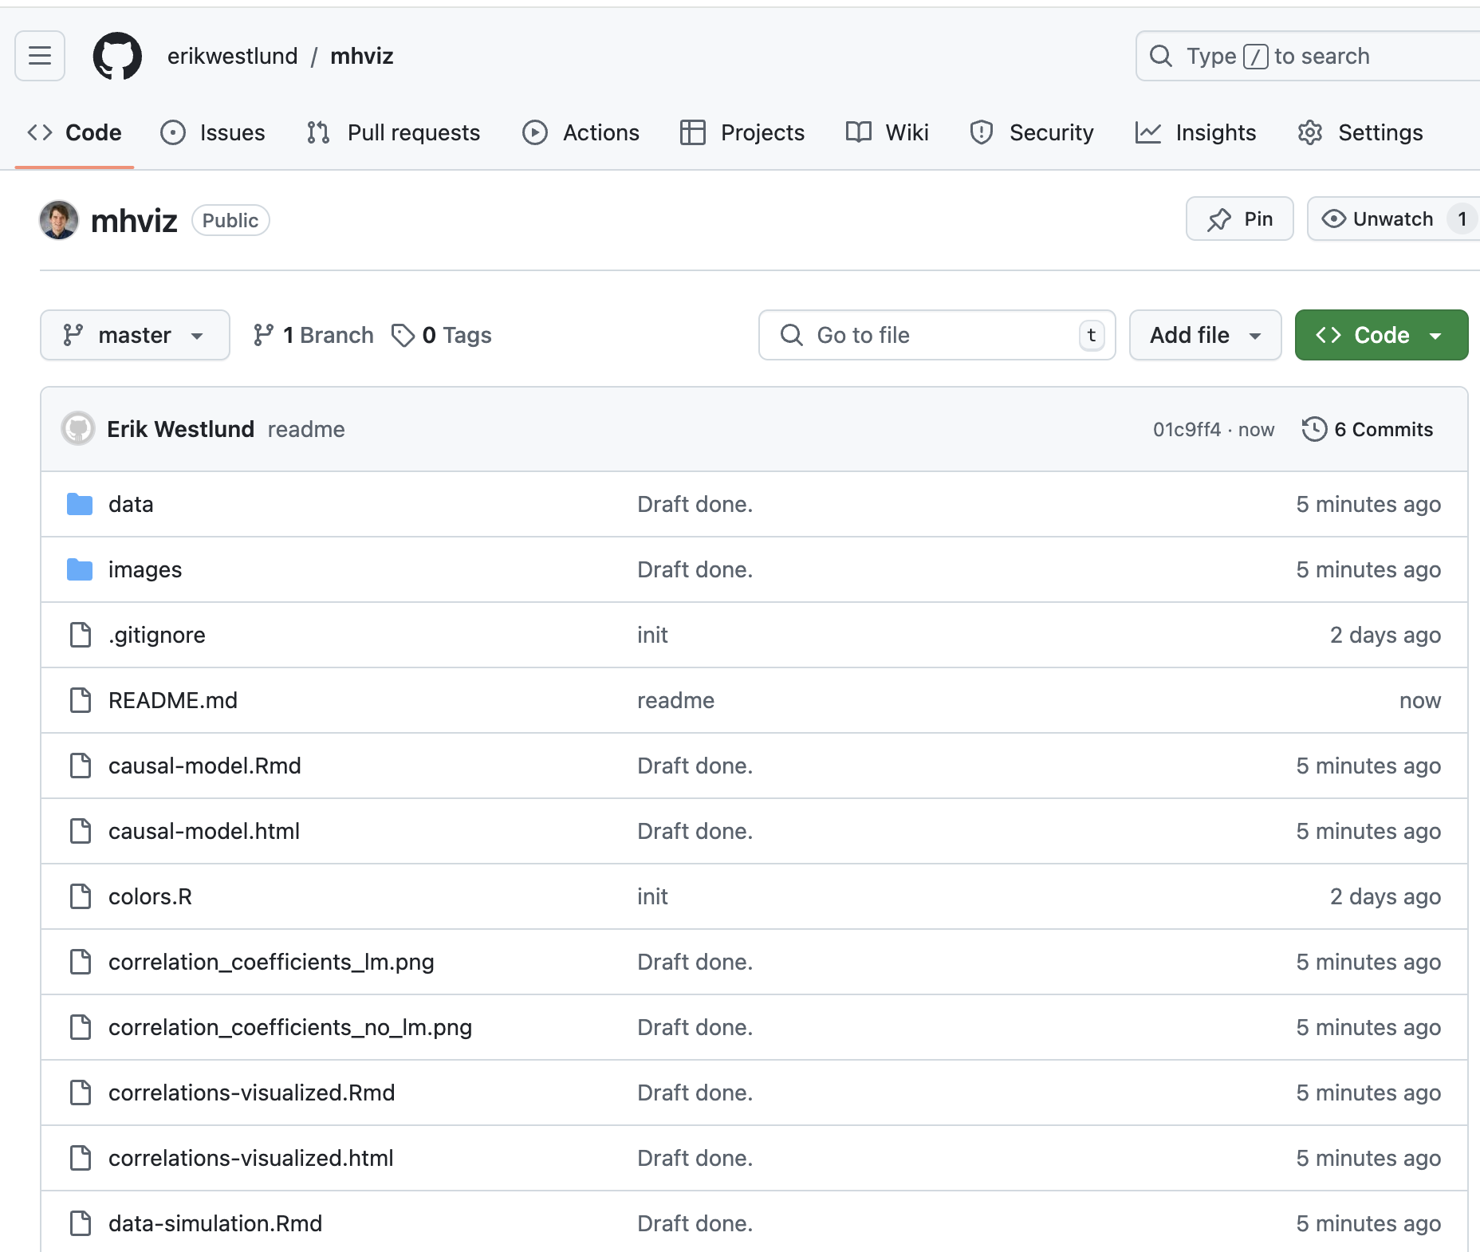
GitHub
All examples from this presentation are available on GitHub at: https://github.com/erikwestlund/mhviz

Slide 4

Edward Tufte
"Graphical excellence is the well-designed presentation of interesting data—a matter of substance, of statistics, and of design…”
The Visual Display of Quantitative Information, 1983

Slide 5
Edward Tufte
“It is that which gives to the view the great number of ideas in the shortest time with the least ink in the smallest space…”

Slide 6
Edward Tufte
“It is nearly always multivariate…”

Slide 7
Edward Tufte
“Graphical excellence requires telling the truth about the data…”

Slide 8

Notes:
This map shows the losses suffered by Napoleon’s army in the Russian campaign of 1812. Beginning at the Polish-Russian border, the thick band shows the size of the army at each position. The path of Napoleon’s retreat from Moscow in the bitterly cold winter is depicted by the dark lower band, which is tied to temperature and time scales.

Slide 9
Edward Tufte
Minard’s classic image “can be described and admired, but there are no compositional principles on how to create that one wonder graphic in a million.”

Slide 10
Edward Tufte
For “more routine, workaday designs… have a properly chosen format and design… use words, numbers, and drawing together, display an accessible complexity of detail… [and] avoid content-free decoration.”

Slide 11
Technology

Slide 12



Tools
I use R, Rstudio, and Tidyverse tools
Your current tools are good enough.
They provide good defaults, but make sure to use them.

Slide 13
Coding Assistants
Use them, just be careful.

Slide 14
Coding assistants
If we’re being honest, however, making the computer create even the most complicated graphics is now trivially easy thanks to ChatGPT.
This, however, results in analysts needing to read more code than they write to ensure correctness
To do this well, it’s important to know basic principles and what is going on under the hood of your software, so I recommend studying the grammar of graphics, the language you are working with, and your tools.

Slide 15
Prompt
I have a plot of auto data. The data set is named "auto." The variables I'm interested are: price, efficiency (variable name: mpg), weight, and manufacturer. The data set only includes the variable "make," which has both the manufacturer and the car name. Can you first split "make" into "manufacturer" and "model." Weight is a continuous measure, but it would be helpful to split this data into categories of small, medium, and large.
I'd then like a plot comparing efficiency to weight. Facet this into small, medium, and large cars. On each figure, annotate the least efficient car with its make and model, one average car with its make and model, and the most efficient car with its make and model.
Use ggplot2 with the minimal theme. Change the type face to "Inter"

Slide 16
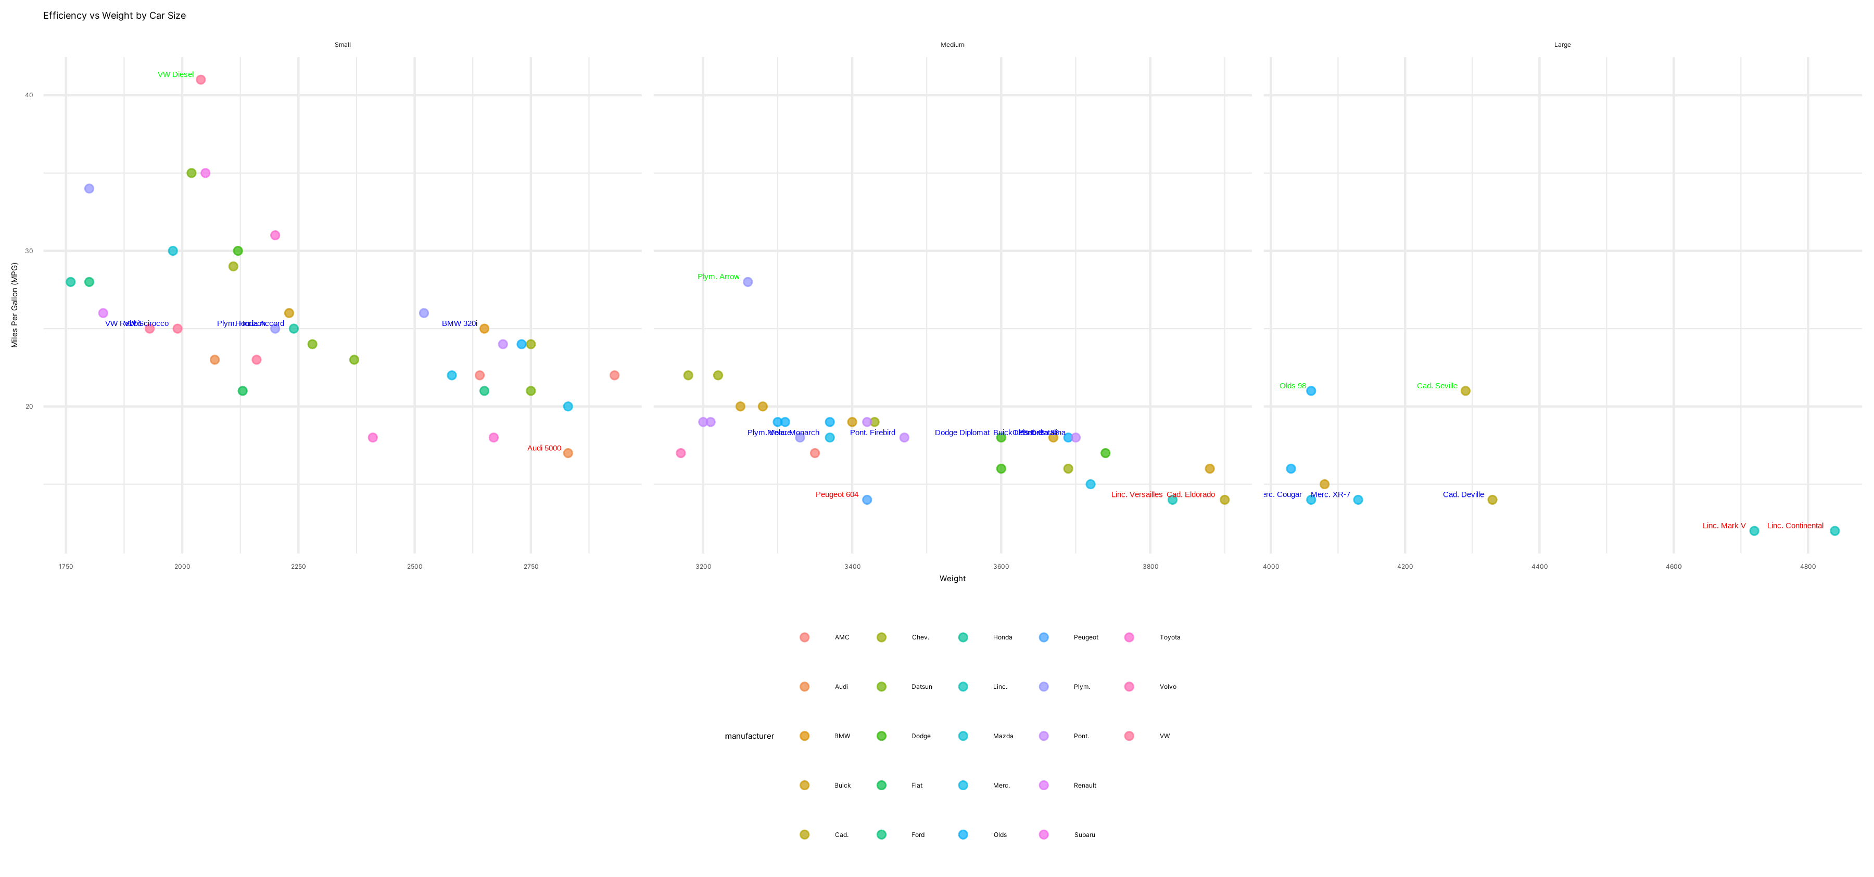

Slide 17
Iteration
That's a good start, but there are issues. For one, the text colors look bad. Can you pick out a color from Tailwind's design system, in the 600 or 700 range? Moreover, the labels need to dodge the points. They are sometime son top of each other. Moreover, it looks like you added more than one car per facet. Please don't do this. There is too much information about manufacturers. So please remove per-manufacturer colors and that legend entirely. Could you add a GAM smoother to each plot? Center the title and make it bold. Make sure we only have three car labels per facet and make sure they are never on top of each other.
…
A few issues. There are not a lot of large cars. Lets start over. By the way, I stored the source auto_data as "source_auto" so you can always start any data manipulations with source_data.
…
okay, good start. Change "Average efficient" to "Average efficiency"
And stop having so many average groups. There's correctly one least and one most. But there are something like five of average efficiency. I believe this is because there are multiples with the same value. Please make sure it picks only one.
…
The text for average is hard to read because its on the line and ribbon. Can we dodge that? We can put the labels farther away and point at them with arrows.
There are ties for least efficient, so you are ending up with two there. You need to do the same thing for least, average, and most. There are no arrows; only for one on least. Can you also make those specific points green, blue, and red (most, average, least) the rest of the points can be a lighter gray.
…
Almost there. Make the points a little darker. You can use tailwind slate 500
then use green 600 for most and red 700 for least.
Change the "vs" in the title to "vs." Make the facet headings bold. And make the x and y axis labels bold.
…
Very close. Make the average dot a blue 700 from tailwind. It's hard to see. Make the weight say Weight (LBS.) and make the smoother ribbon just a little less dark.
…
OK. Very close. Change "LBS" to "lbs." Make the blue dot darker. And change the title to "Efficiency vs. Weight for Compact and Large Cars”
…
change "Large Cars" to "Full-size Cars”
…
can you make the text a little bigger all around so i can see it better on powerpoint

Slide 18
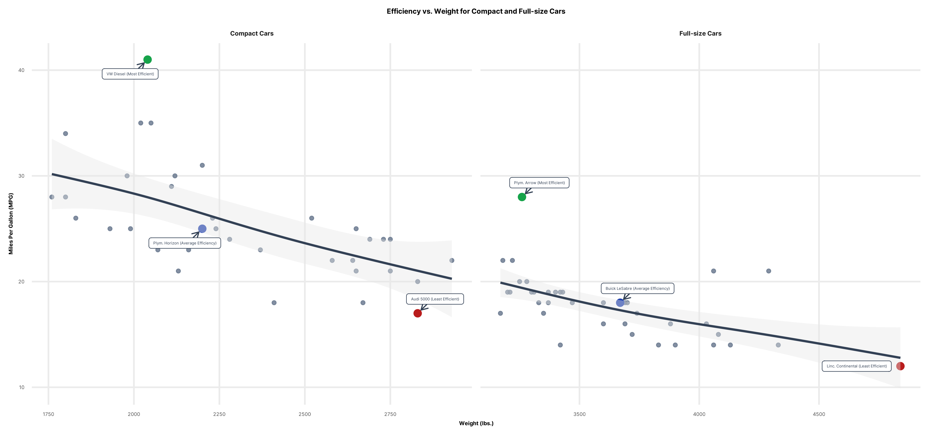

Slide 19
Design
Choose sensible defaults

Slide 20
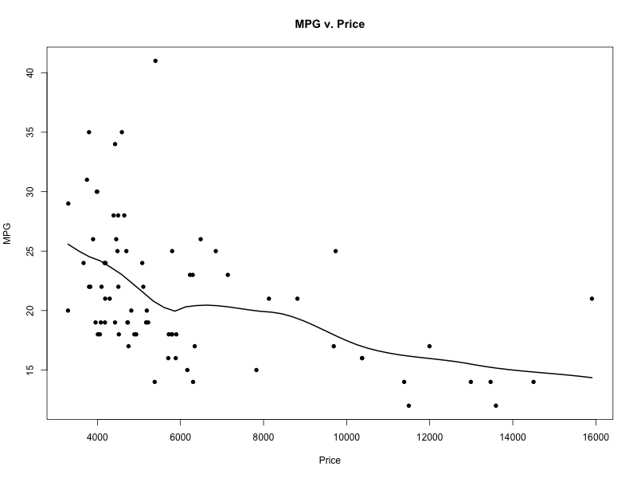

loess <- loess(mpg ~ price, auto, span = 0.5, degree = 1)
loess.x <- seq(min(auto$price), max(auto$price), length.out = 50)
loess.y <- predict(loess, loess.x)
plot(x = auto$price, y = auto$mpg, pch = 16, xlab = "Price", ylab = "MPG", main = "MPG v. Price")
lines(loess.x, loess.y, lwd = 2)

Slide 21
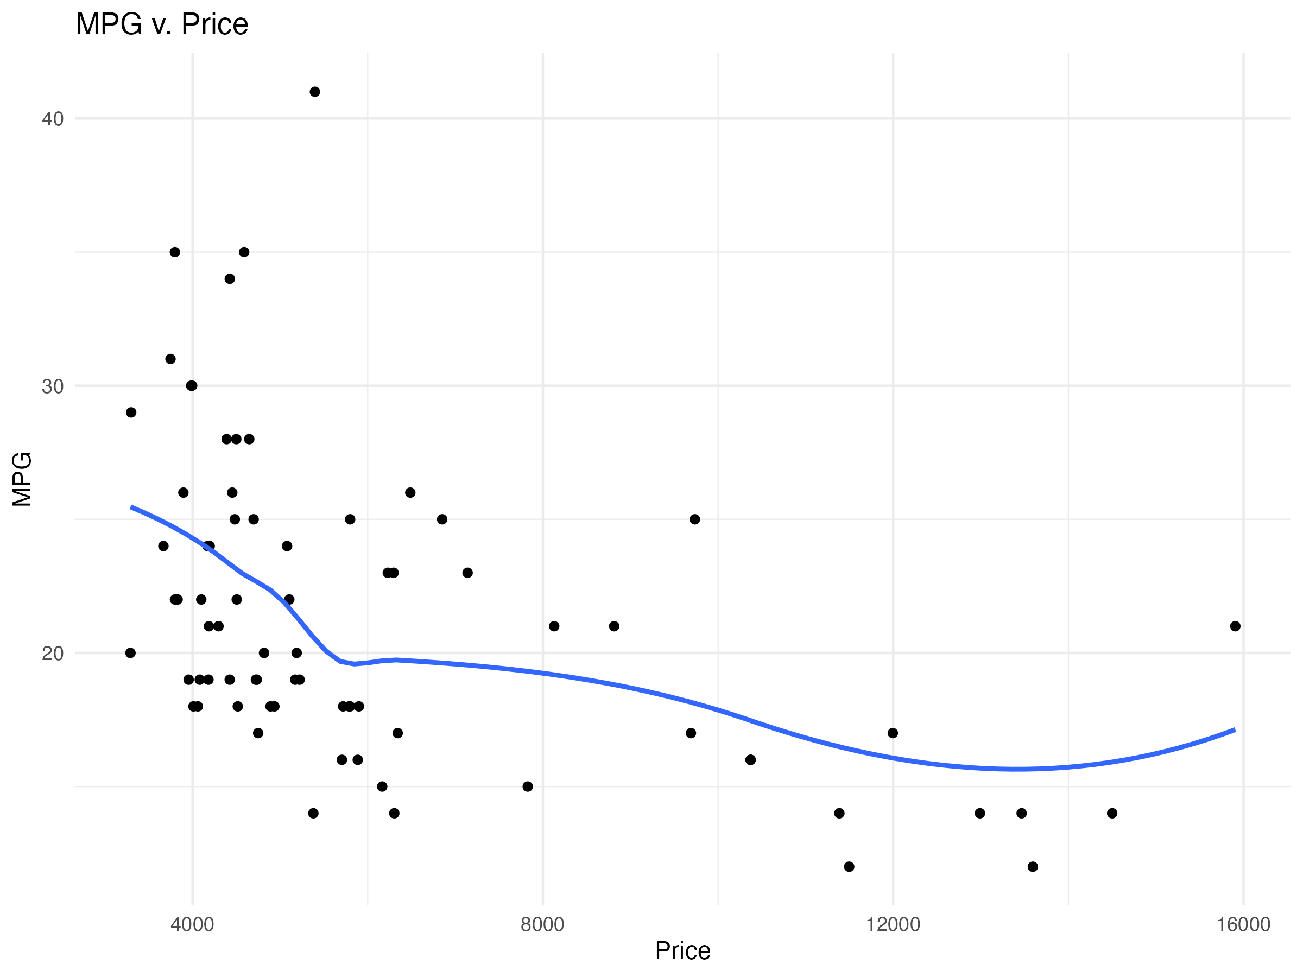

ggplot(auto, aes(x = price, y = mpg)) +
geom_point() +
geom_smooth(method = "loess", se = FALSE) +
labs(x = "Price", y = "MPG", title = "MPG v. Price") +
theme_minimal()

Slide 22
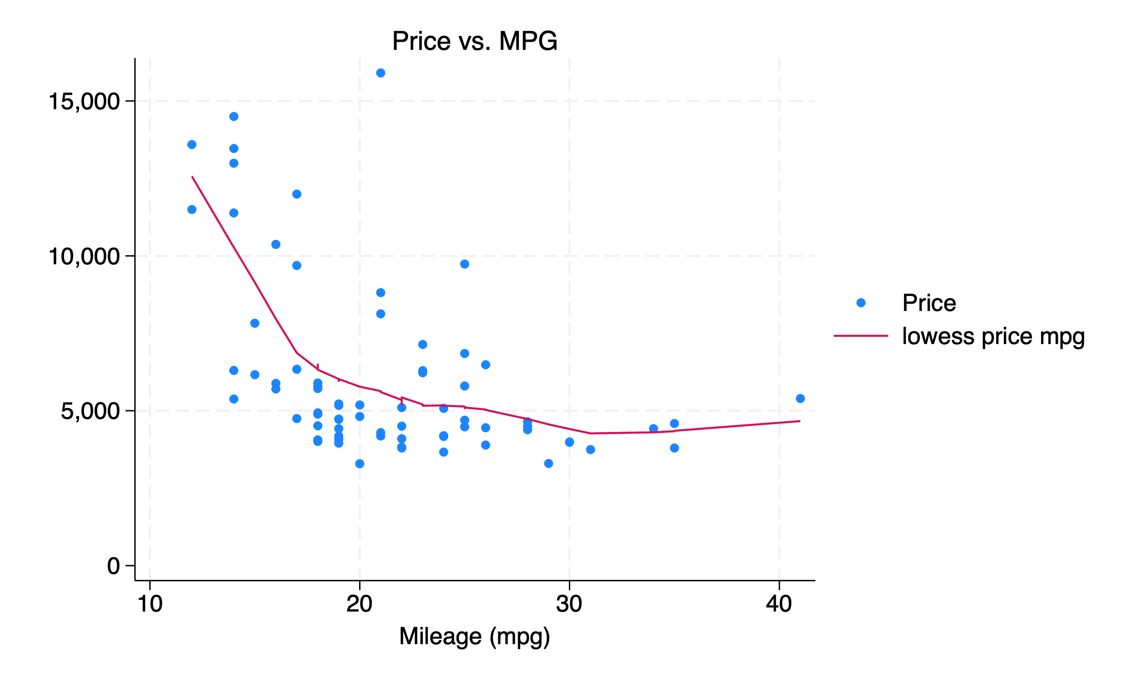
twoway (scatter mpg) (lowess price mpg), subtitle("Price vs. MPG")

Slide 23
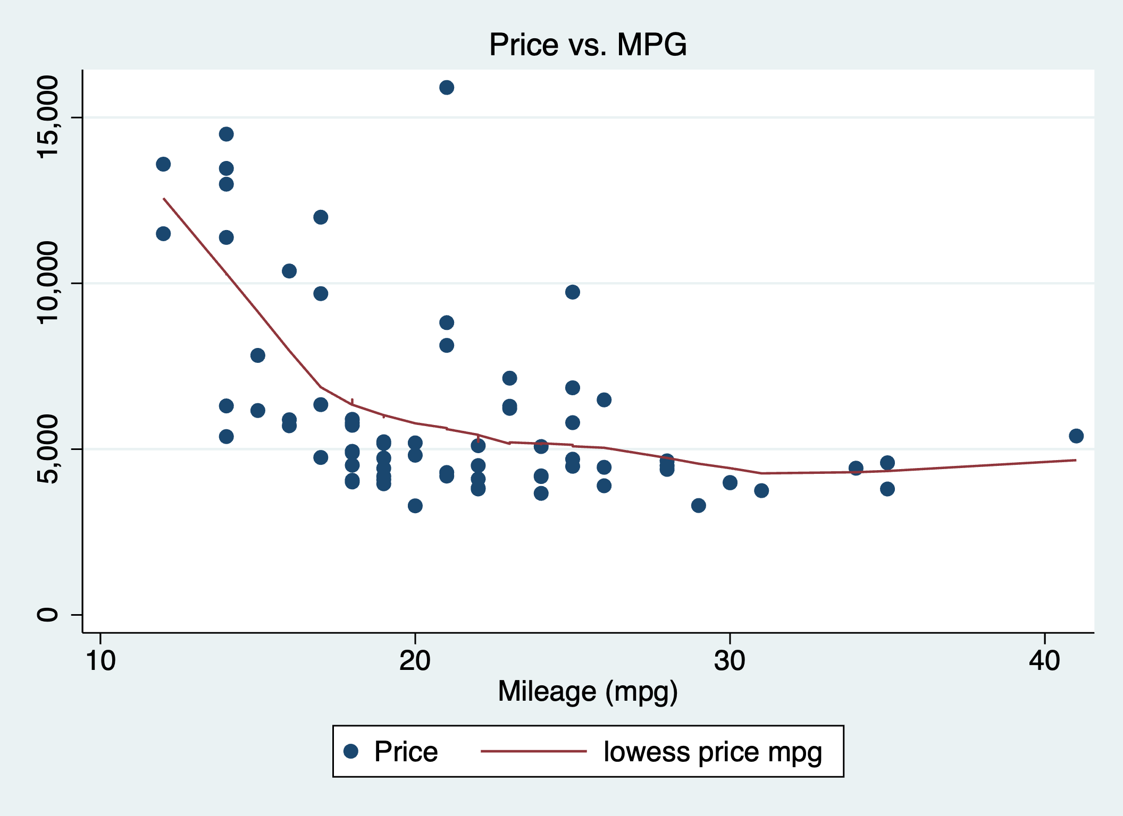

twoway (scatter mpg) (lowess price mpg), subtitle("Price vs. MPG") scheme(s2color)

Slide 24
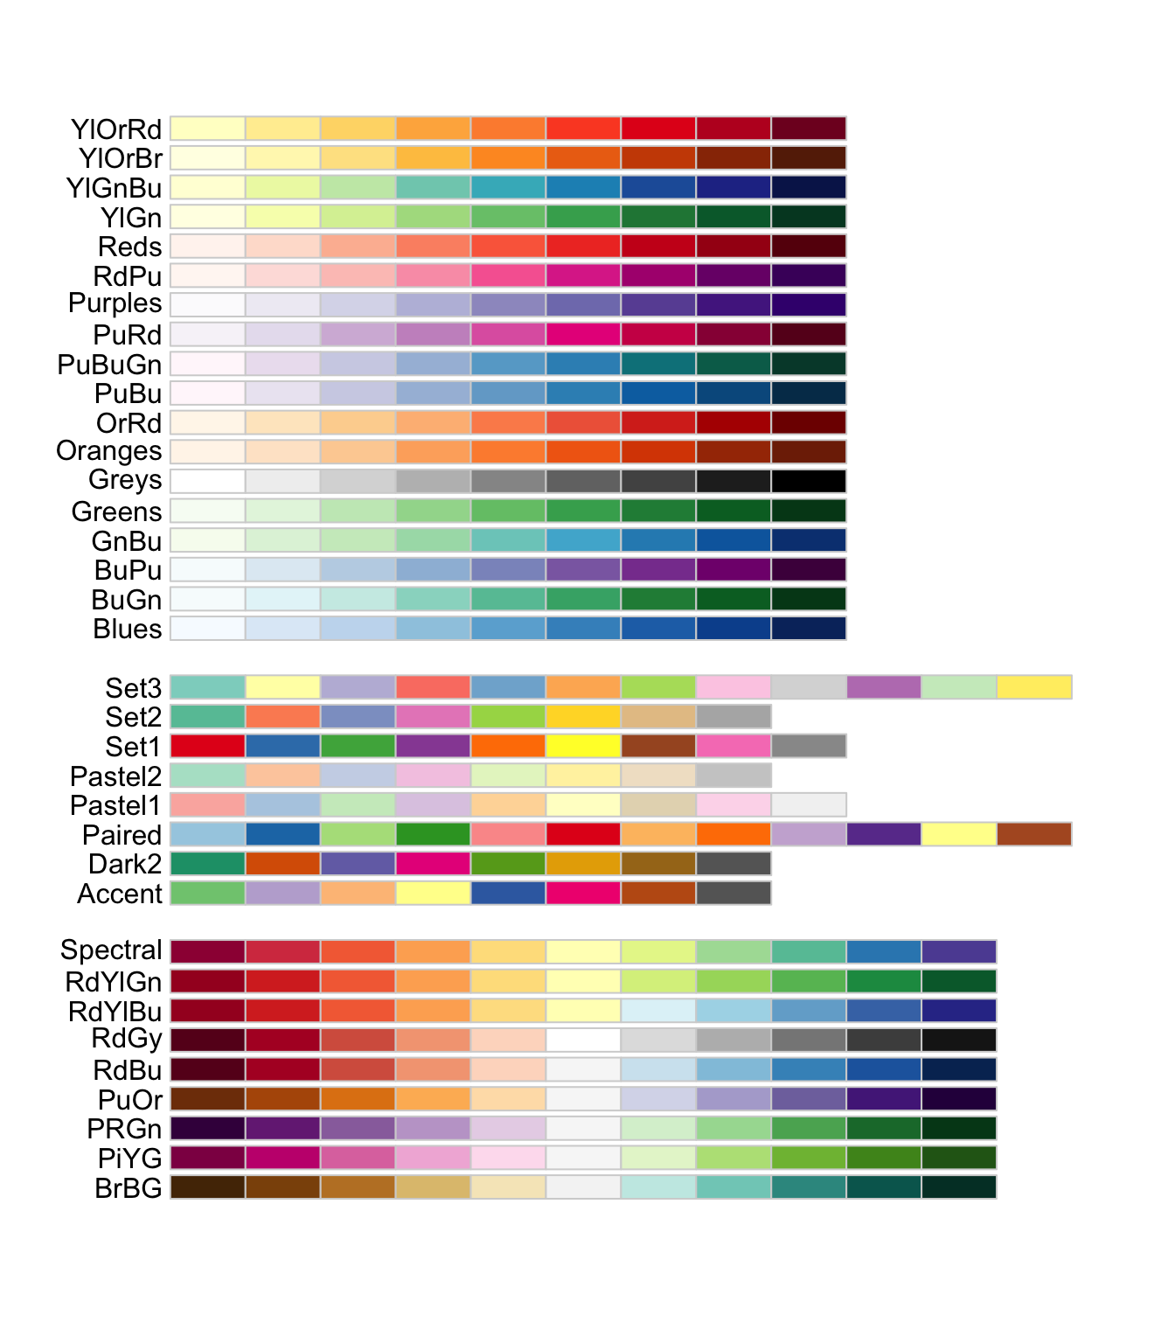
Colors & Color Schemes
The RColorBrewer package gives good default color schemes that are accessible (i.e., easy to read for everyone) and aesthetically pleasing.
ggplot by default picks out pleasing colors that are distinguishable from each other by the human eye.

Slide 25
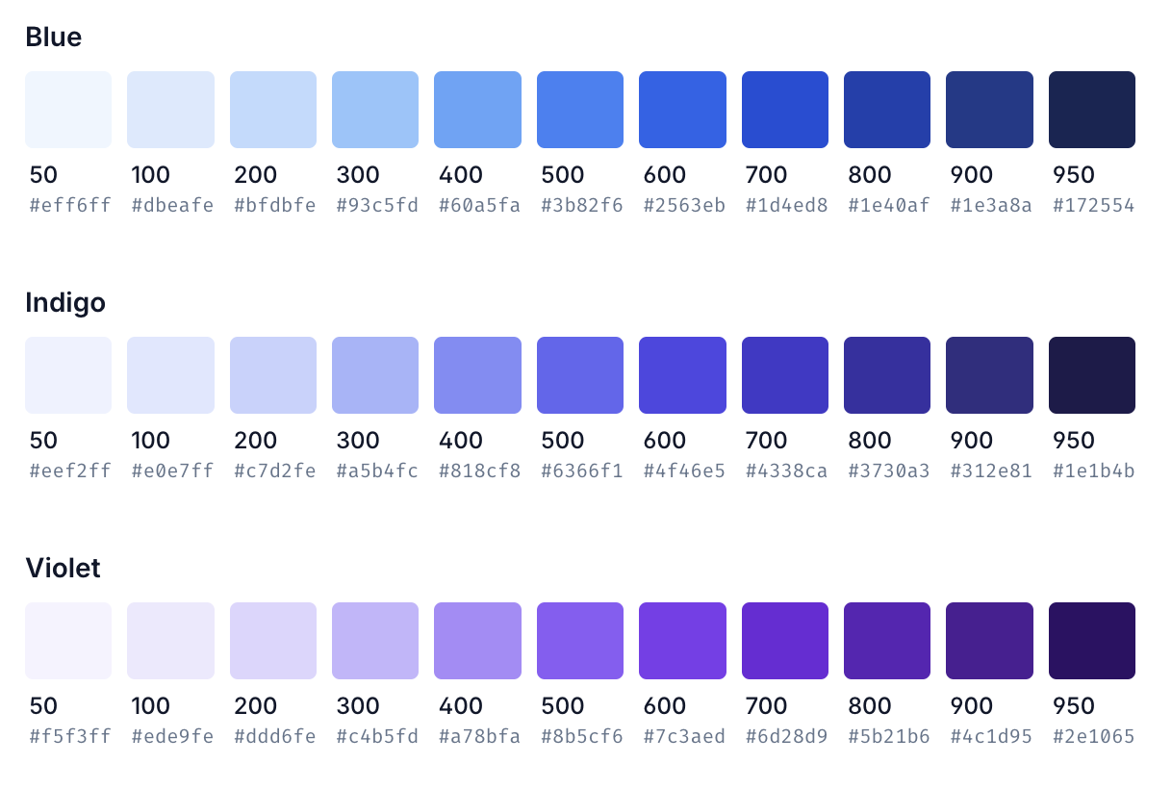
Custom colors
If you want good custom color palettes, I included R code to easily access the TailwindCSS design system defaults in `colors.R`
Use with discretion on complex plots!
Accessibility Color Checker: https://webaim.org/resources/contrastchecker/

Slide 26
Code
The grammar of graphics

Slide 27
The grammar of graphics
The “gg” in ggplot2 stands for the grammar of graphics, a concept coined by Leland Wilkinson and popularized by Hadley Wickham
Grammar in language is a set of rules for how language is structured
Grammar in graphics is a set of rules for how visual representations of data are structured.

Slide 28
Key concepts
Data
Aesthetic Mapping
Geom
Position/Fill
Scales/Coordinates
Labels
Guides
Facets

Slide 29
Aesthetic mapping
How your variables map onto the aesthetics of your figure
It sounds highfalutin, but it usually just means:
What is your x?
What is your y?

Slide 30
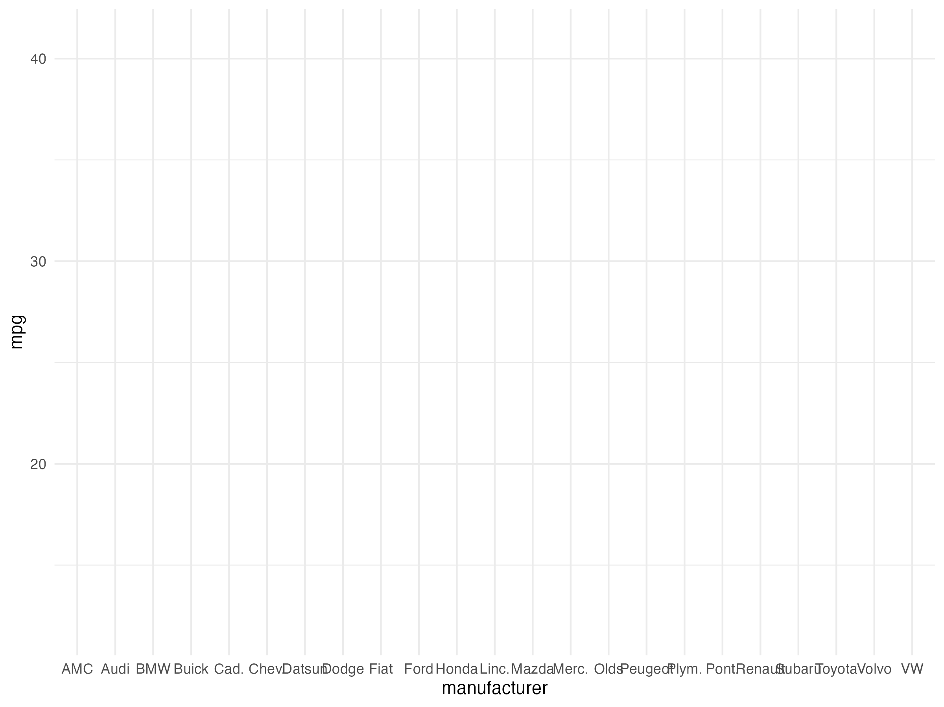
ggplot(auto, aes(x = manufacturer, y = mpg)) +
theme_minimal()
Aesthetic mapping only, no geom.

Slide 31
Geoms
Geoms are just the elements used to represent the data
Geoms have associated stats/functions/statistical transformations
Stats such as counts for groups often involve aggregations
Geom | R function | Stat/Transformation | Use for
Point | geom_point | Identity | Scatter plots
Bar | geom_bar | Count | Bar plots
AB Line | geom_abline | Slope | Line plots
Horizontal line | geom_hline | Y intercept
Vertical line | geom_vline | X intercept
Smoother | geom_smooth | Smoothing f unction (GAM, Loess, etc.) | Showing patterns/trends
Reference: https://ggplot2.tidyverse.org/reference/

Slide 32
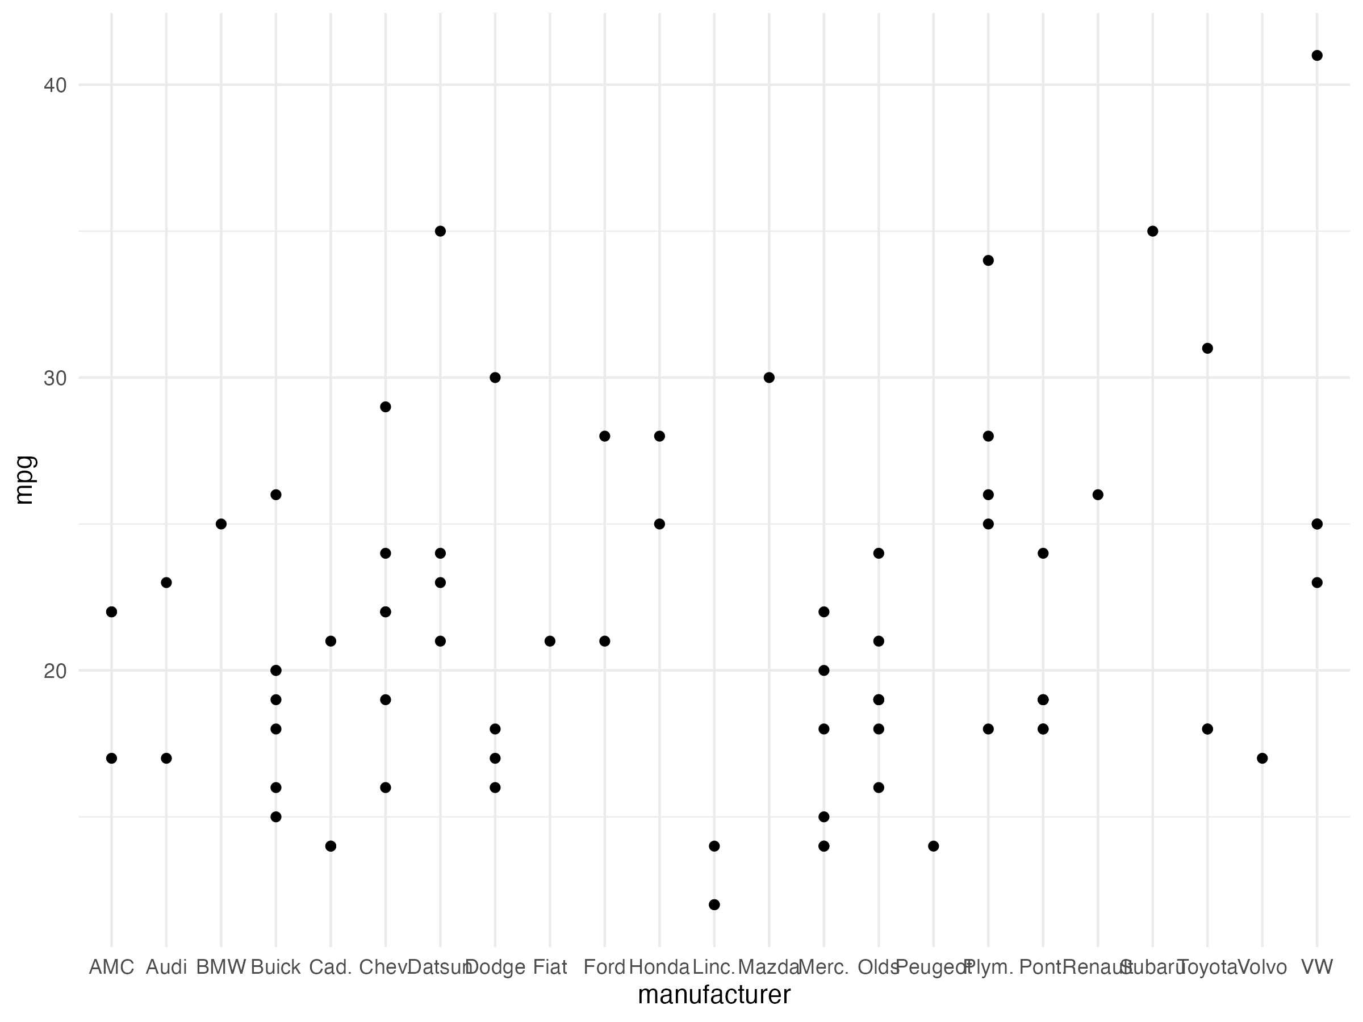
ggplot(auto, aes(x = manufacturer, y = mpg)) +
geom_point() +
theme_minimal()
Aesthetic mapping & point

Slide 33
Position/Fill
You can use position/fill to move elements around and color code geoms by aspects of the data, such as categories.
For example, with a bar chart:
“stack:” Stack bars on top of each other
“fill”: Stack bars, but make them always fill up vertical space to 1
“dodge:” Put the bars next to each other
Tip: When you reach for fill, always consider faceting in small multiples. The brain struggles with fills. More on this later.

Slide 34
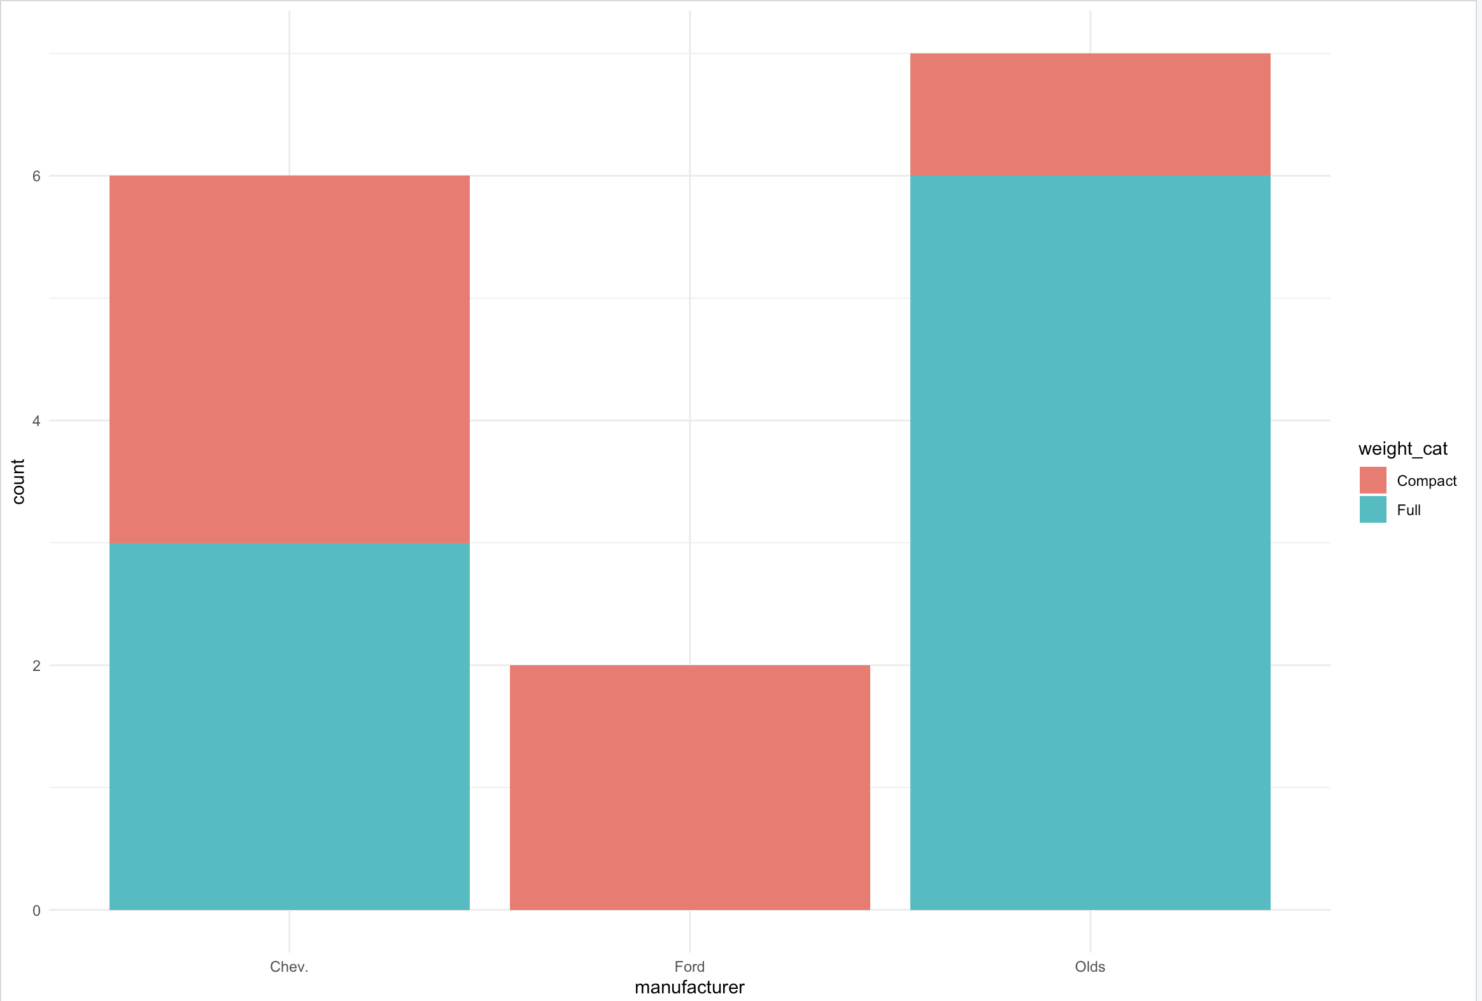
ggplot(american_data, aes(x = manufacturer, fill = weight_cat)) +
geom_bar() +
theme_minimal()

Slide 35
Aggregations
To make a bar chart, one groups data and takes a mean, proportion, or count
Software like ggplot will try to do this for you and it works well for simple cases
This can fall over with more difficult aggregations or when doing things like applying annotation labels
A powerful and frustration-reducing technique is to do the aggregation yourself and then use the “identity” mapping
This separates the statistical logic from the visual logic and is often what makes a tricky figure easier to make
https://ggplot2.tidyverse.org/reference/

Slide 36
Substance & Statistics
“Good, honest graphics”

Slide 37
Let Science Decide
Data visualization is valuable for its scientific application
It helps in:
Choosing what to visualize
Understanding your data
Understanding your models
Communicating your findings in an impactful way

Slide 38
Understanding Your Data
> model <- lm(y ~ x, data = analysis_data)
> summary(model)
Call:
lm(formula = y ~ x, data = analysis_data)
Residuals:
Min 1Q Median 3Q Max
-0.19848 -0.07113 -0.00910 0.06042 0.34241
Coefficients:
Estimate Std. Error t value Pr(>|t|)
(Intercept) -0.00313 0.01015 -0.308 0.75846
x 0.03463 0.01112 3.113 0.00243 **
---
Signif. codes: 0 ‘***’ 0.001 ‘**’ 0.01 ‘*’ 0.05 ‘.’ 0.1 ‘ ’ 1
Residual standard error: 0.101 on 98 degrees of freedom
Multiple R-squared: 0.09, Adjusted R-squared: 0.08071
F-statistic: 9.692 on 1 and 98 DF, p-value: 0.002426
> cor(analysis_data$x, analysis_data$y)
[1] 0.3
For every one unit increase in x, y increases 0.03, right?

Slide 39
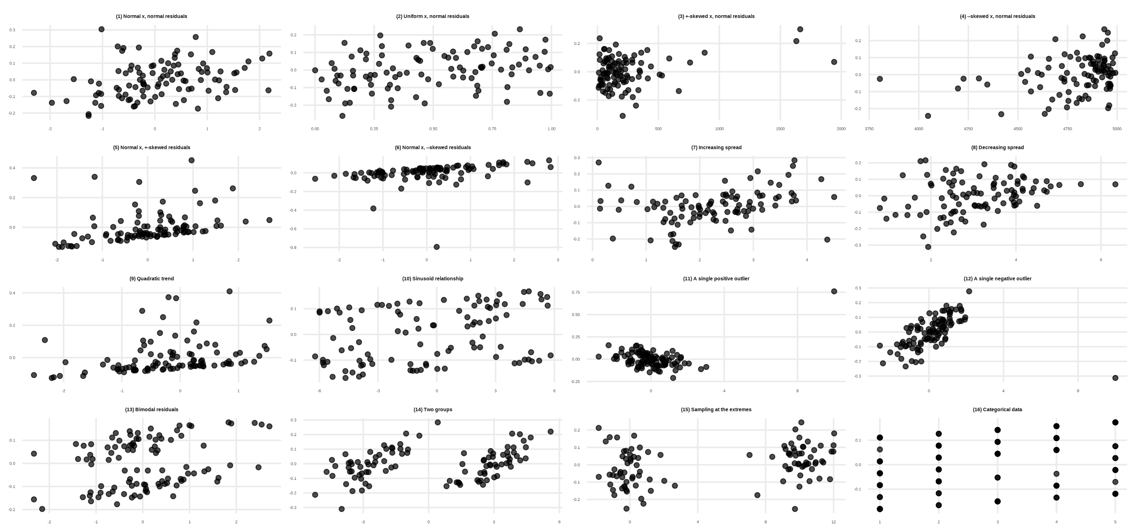
N=100

Slide 40
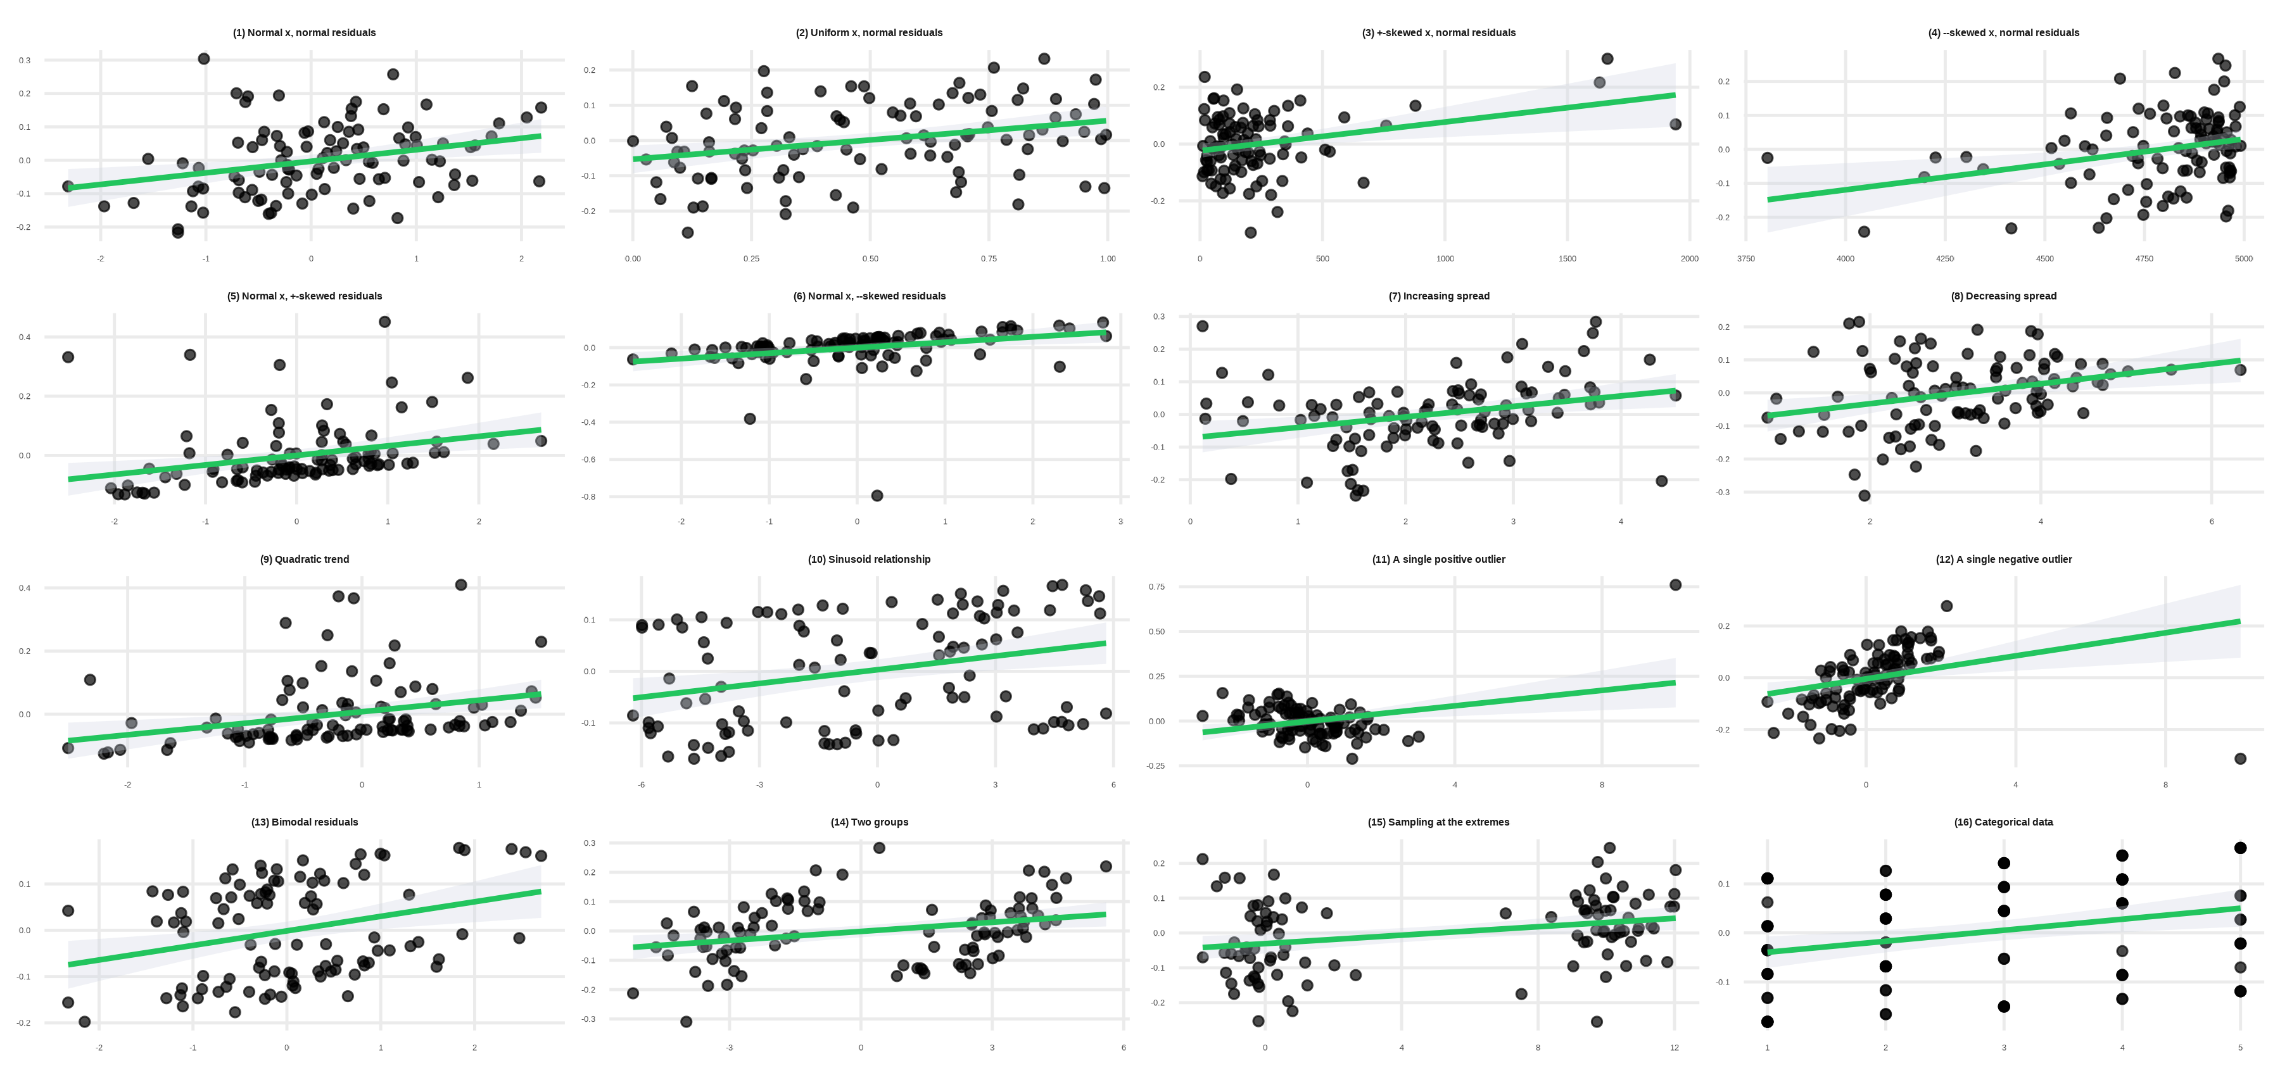
N=100
r = 0.30 for all data sets!

Slide 41
Looking At Data
reg y x, robust is not enough (even with the robust flag)
Visual inspection of your data is a crucial step of scientific investigation

Slide 42
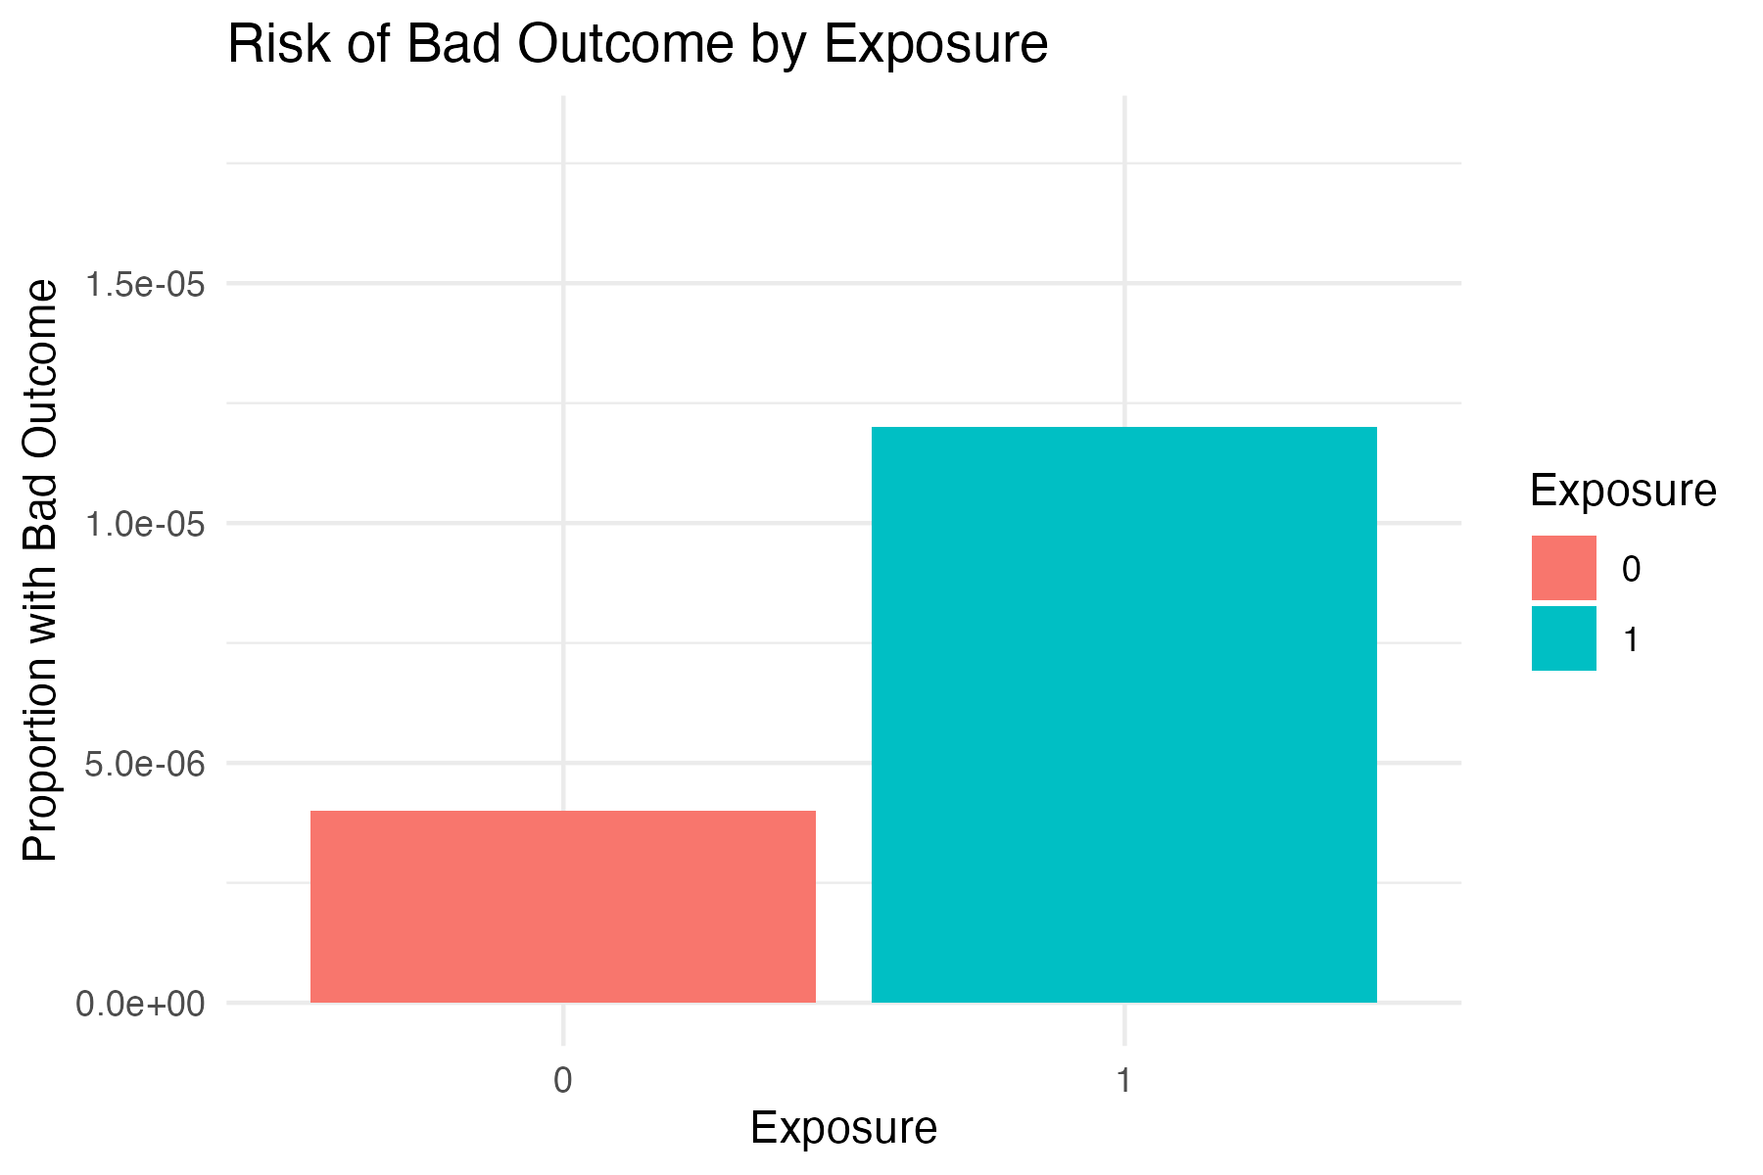
Scales & Axes
If there is one way someone can “lie with statistical visualizations,” it’s by constraining axes and scales in a misleading way.
glm(formula = bad_outcome ~ exposure, family = "binomial", data = data)
Coefficients:
Estimate Std. Error z value Pr(>|z|)
(Intercept) -12.430 1.000 -12.430 <2e-16 ***
exposure 1.100 1.155 0.952 0.341
---
Signif. codes: 0 ‘***’ 0.001 ‘**’ 0.01 ‘*’ 0.05 ‘.’ 0.1 ‘ ’ 1
> exp(1.10)
[1] 3.00416

Slide 43
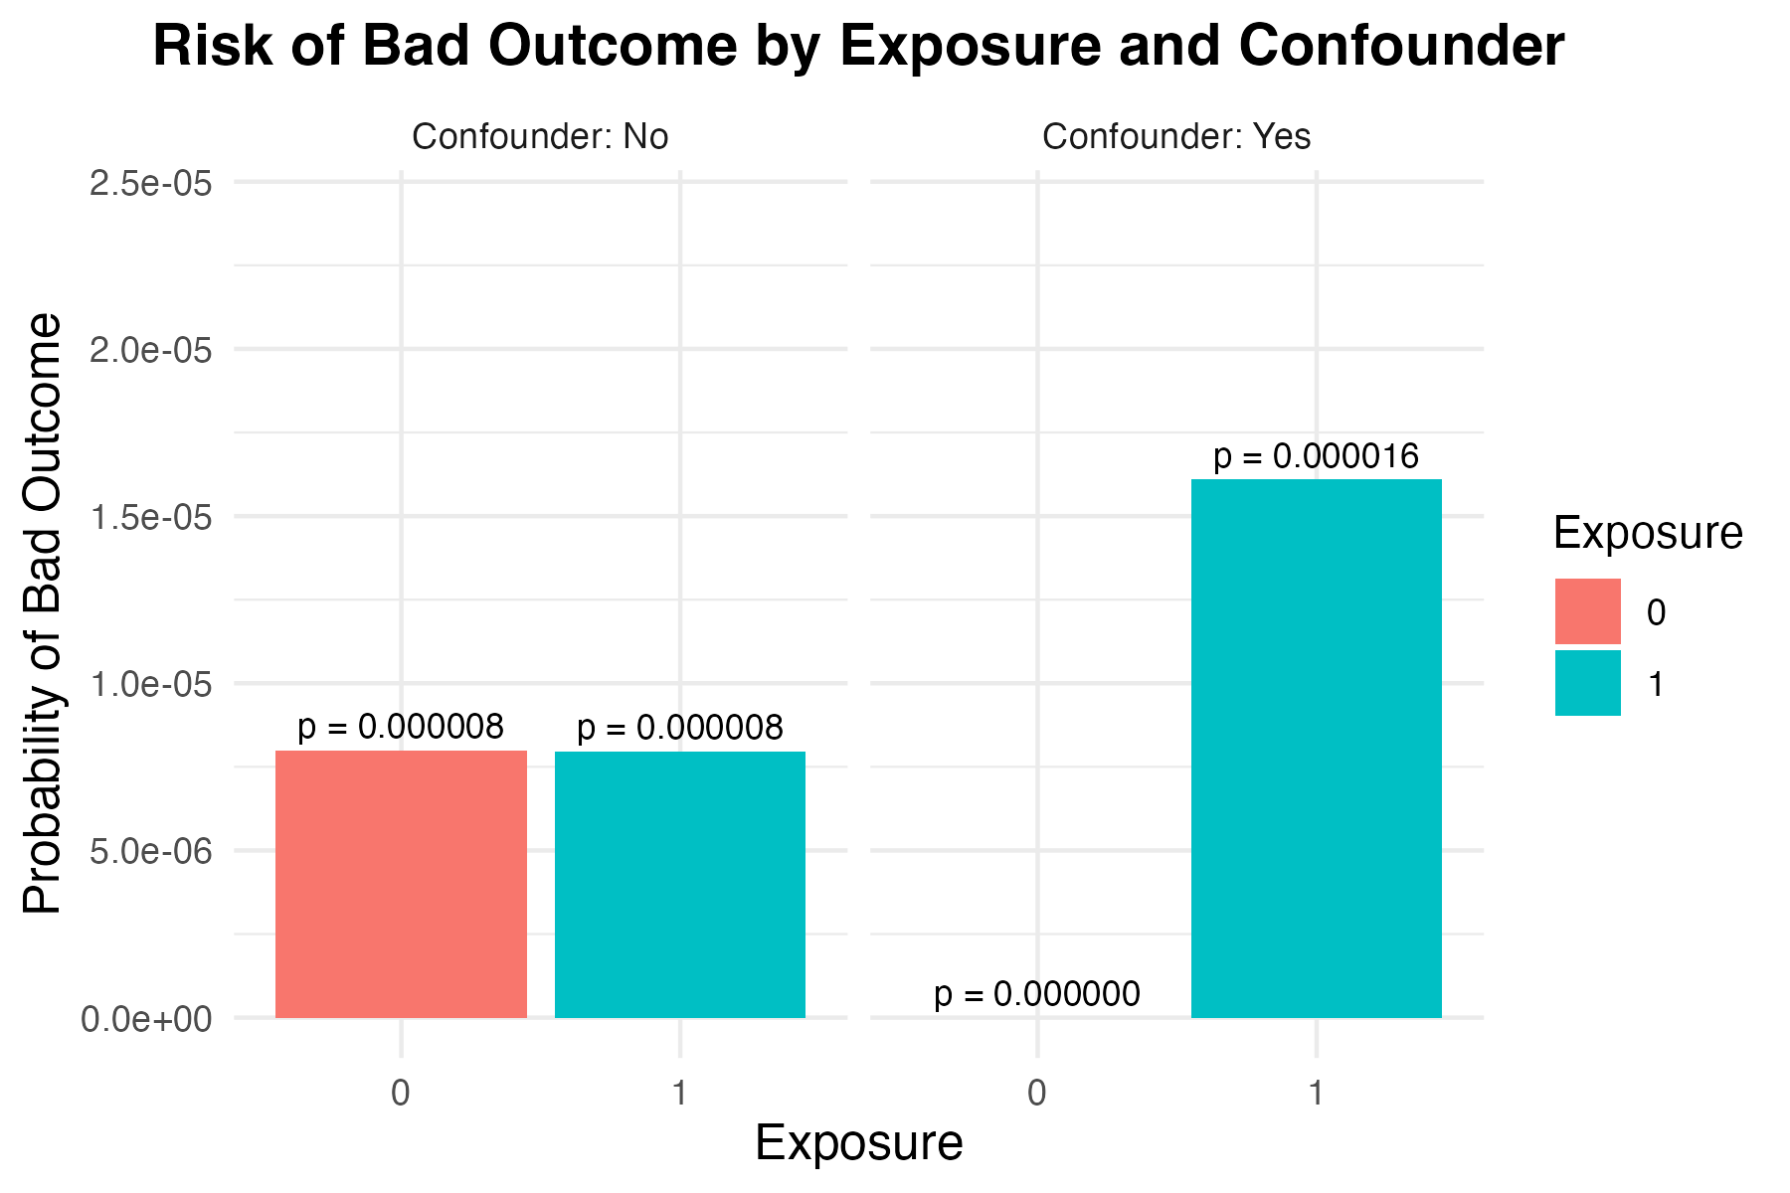

Slide 44
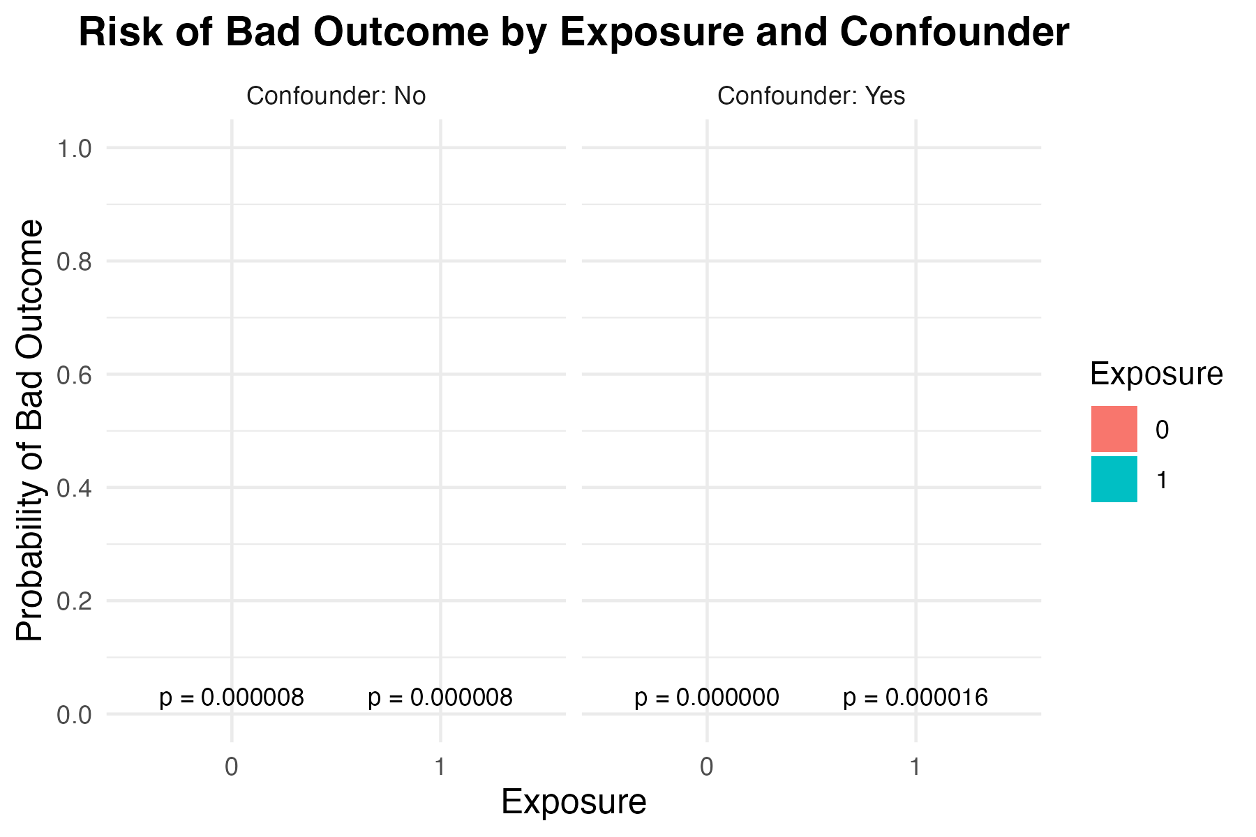

Slide 45
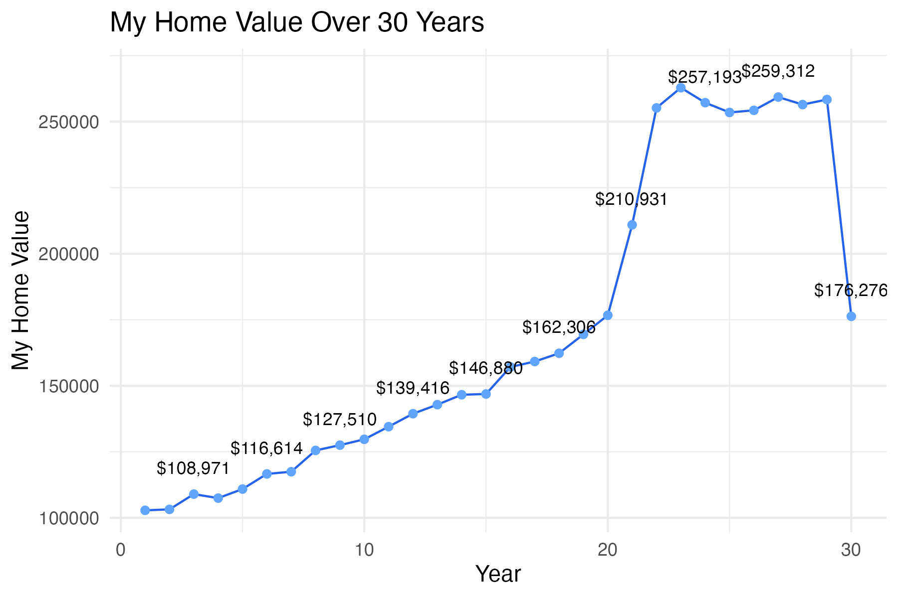

Slide 46
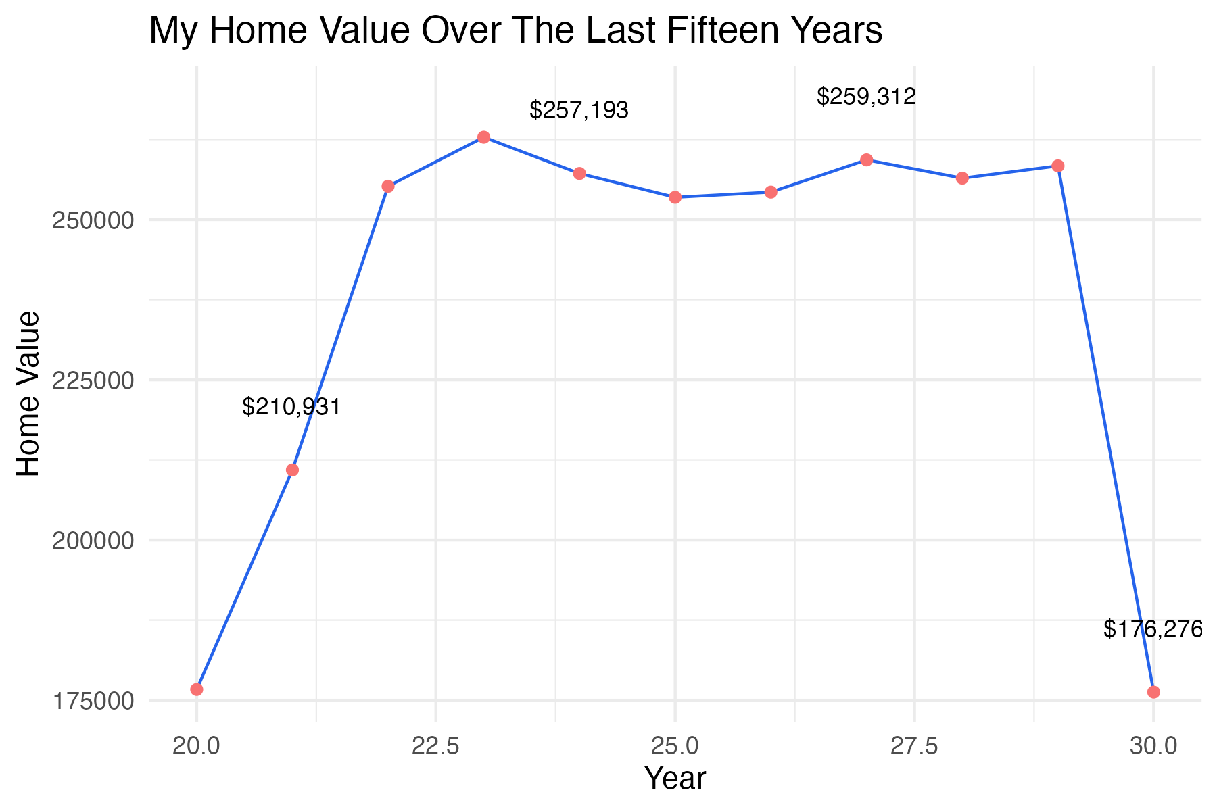

Slide 47
How misleading are these, actually?
Providing appropriate context often makes seemingly misleading images a lot less misleading.

Slide 48
Why do pie charts suck?
When comparing magnitudes, try to use “position on a common scale”
Research shows people are best able to distinguish magnitudes

Slide 49
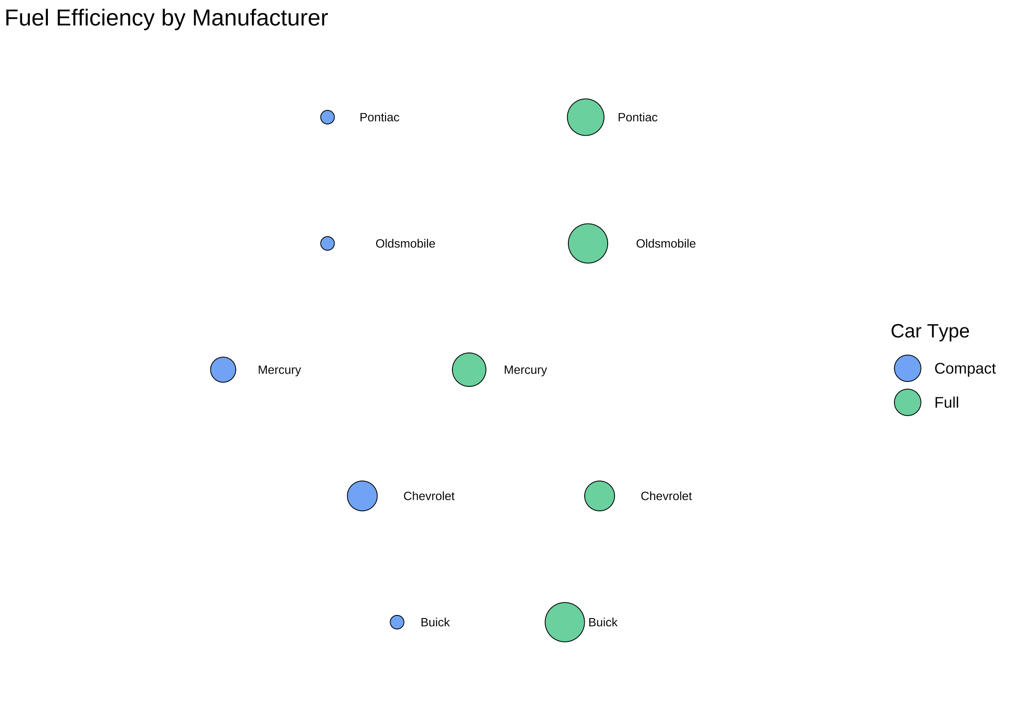
Worst: Area/volume

Slide 50
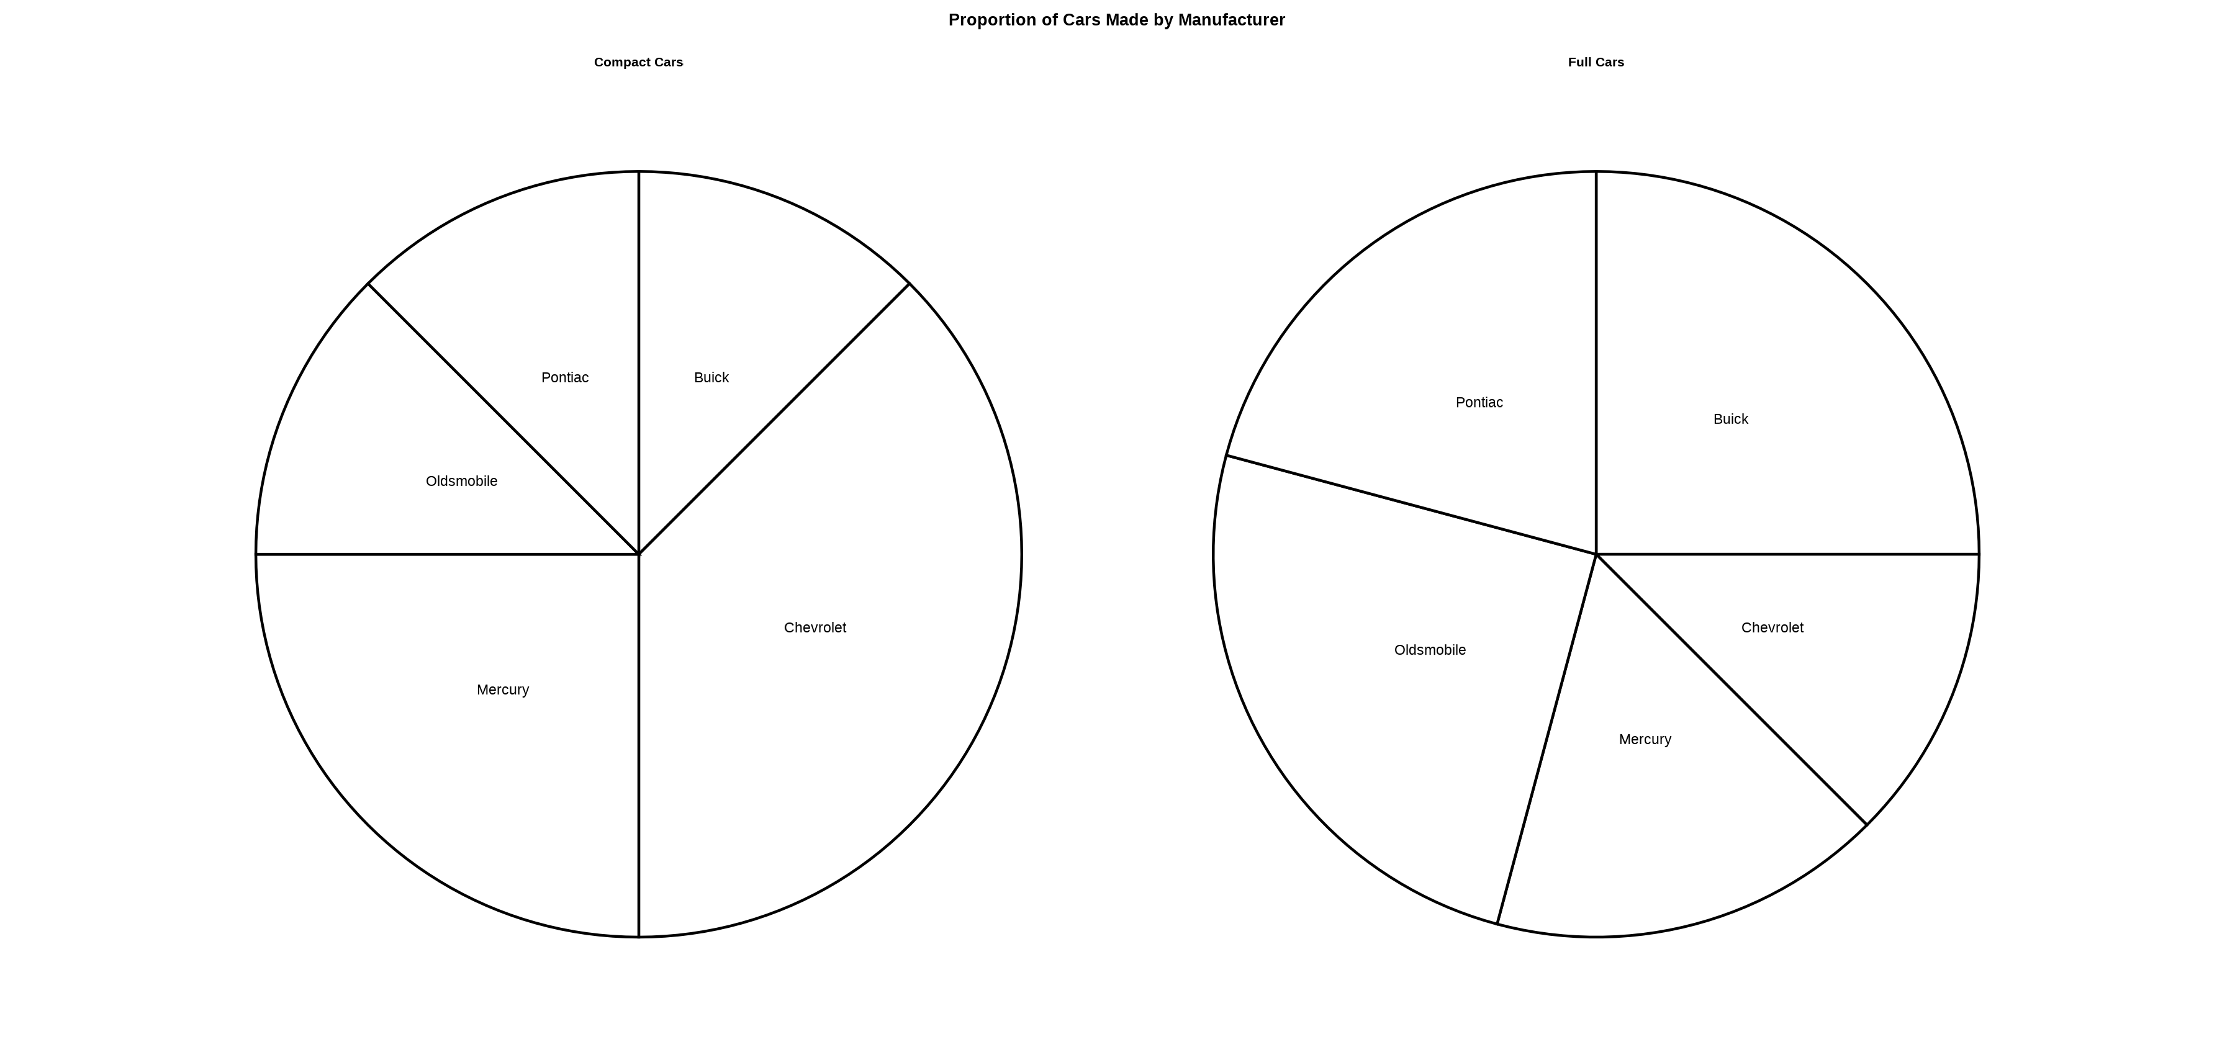
Bad: Angles

Slide 51
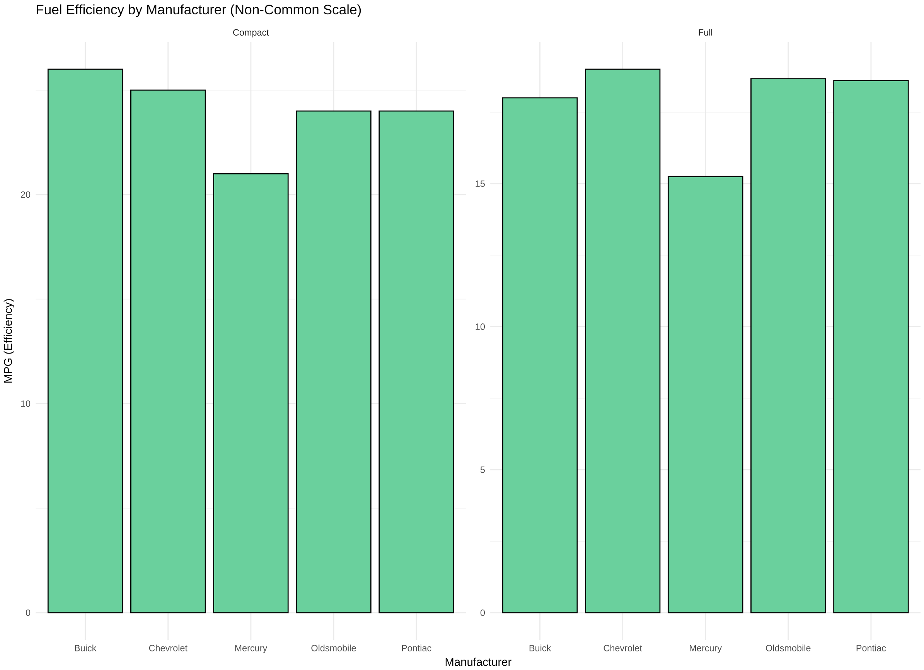
Better: Position on a scale

Slide 52
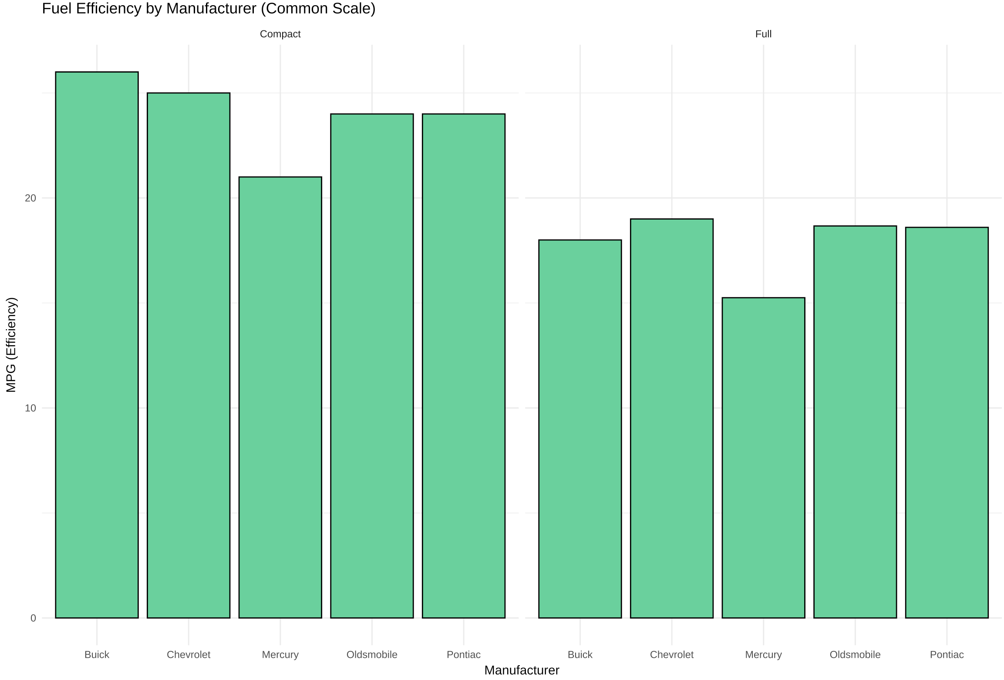
Best: Position on a common scale

Slide 53
What Should I Visualize?

Slide 54
Develop A Causal Model
Causal models should drive our analyses and our visualization
Yes, even when “just looking at associations”
Visualization can also be a tool for developing and understanding your causal model.

Slide 55
Hypothetical Research Study
What causes mothers to receive comprehensive postnatal care?

Slide 56
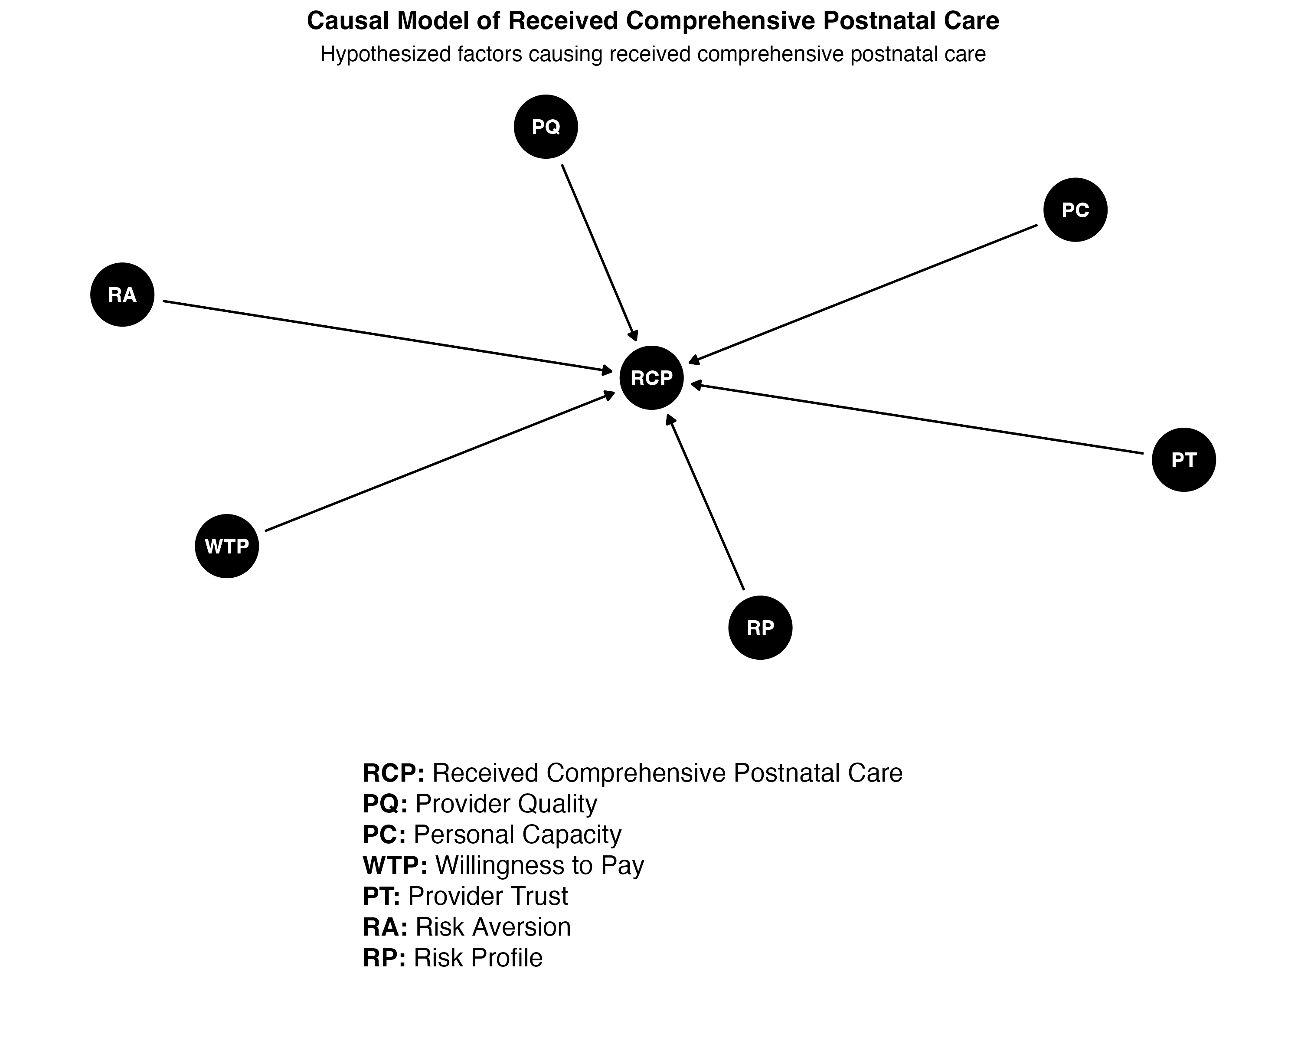
formula("RCP ~ PQ + PC + WTP + PT + RA + RP")

Slide 57
Causal complexity
Let’s go further down the causal tree and hypothesize the causes of our causes:
formula("PQ ~ PEC")
formula("PC ~ DEP + JOB + INC + DIS")
formula("WTP ~ PQ + INC + INS + RA + CO")
formula("PT ~ PQ + RE + CO")
formula("RA ~ PQ + RP + INS")
formula("RP ~ PQ + AGE + OBE + MG + DM + HD + PP + PR + HT + GHT")

Slide 58
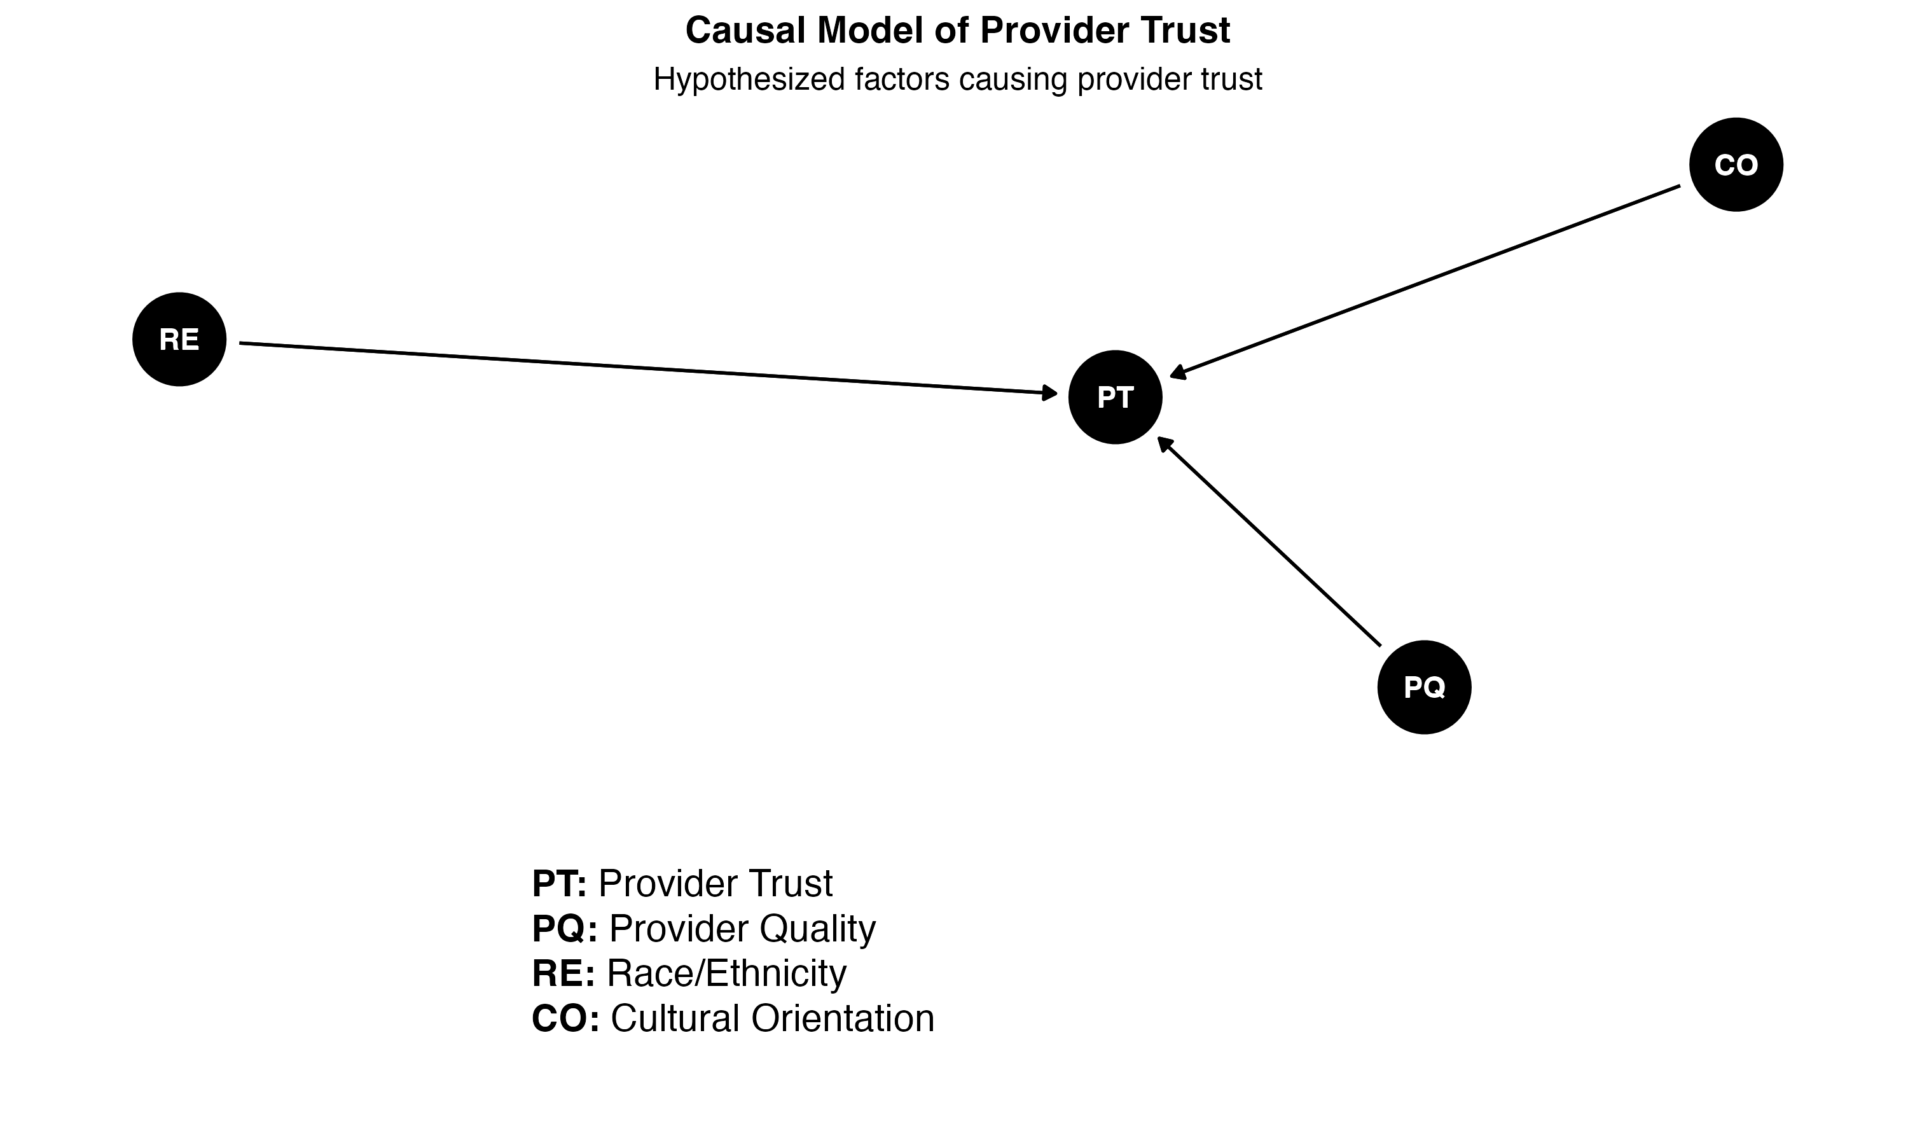
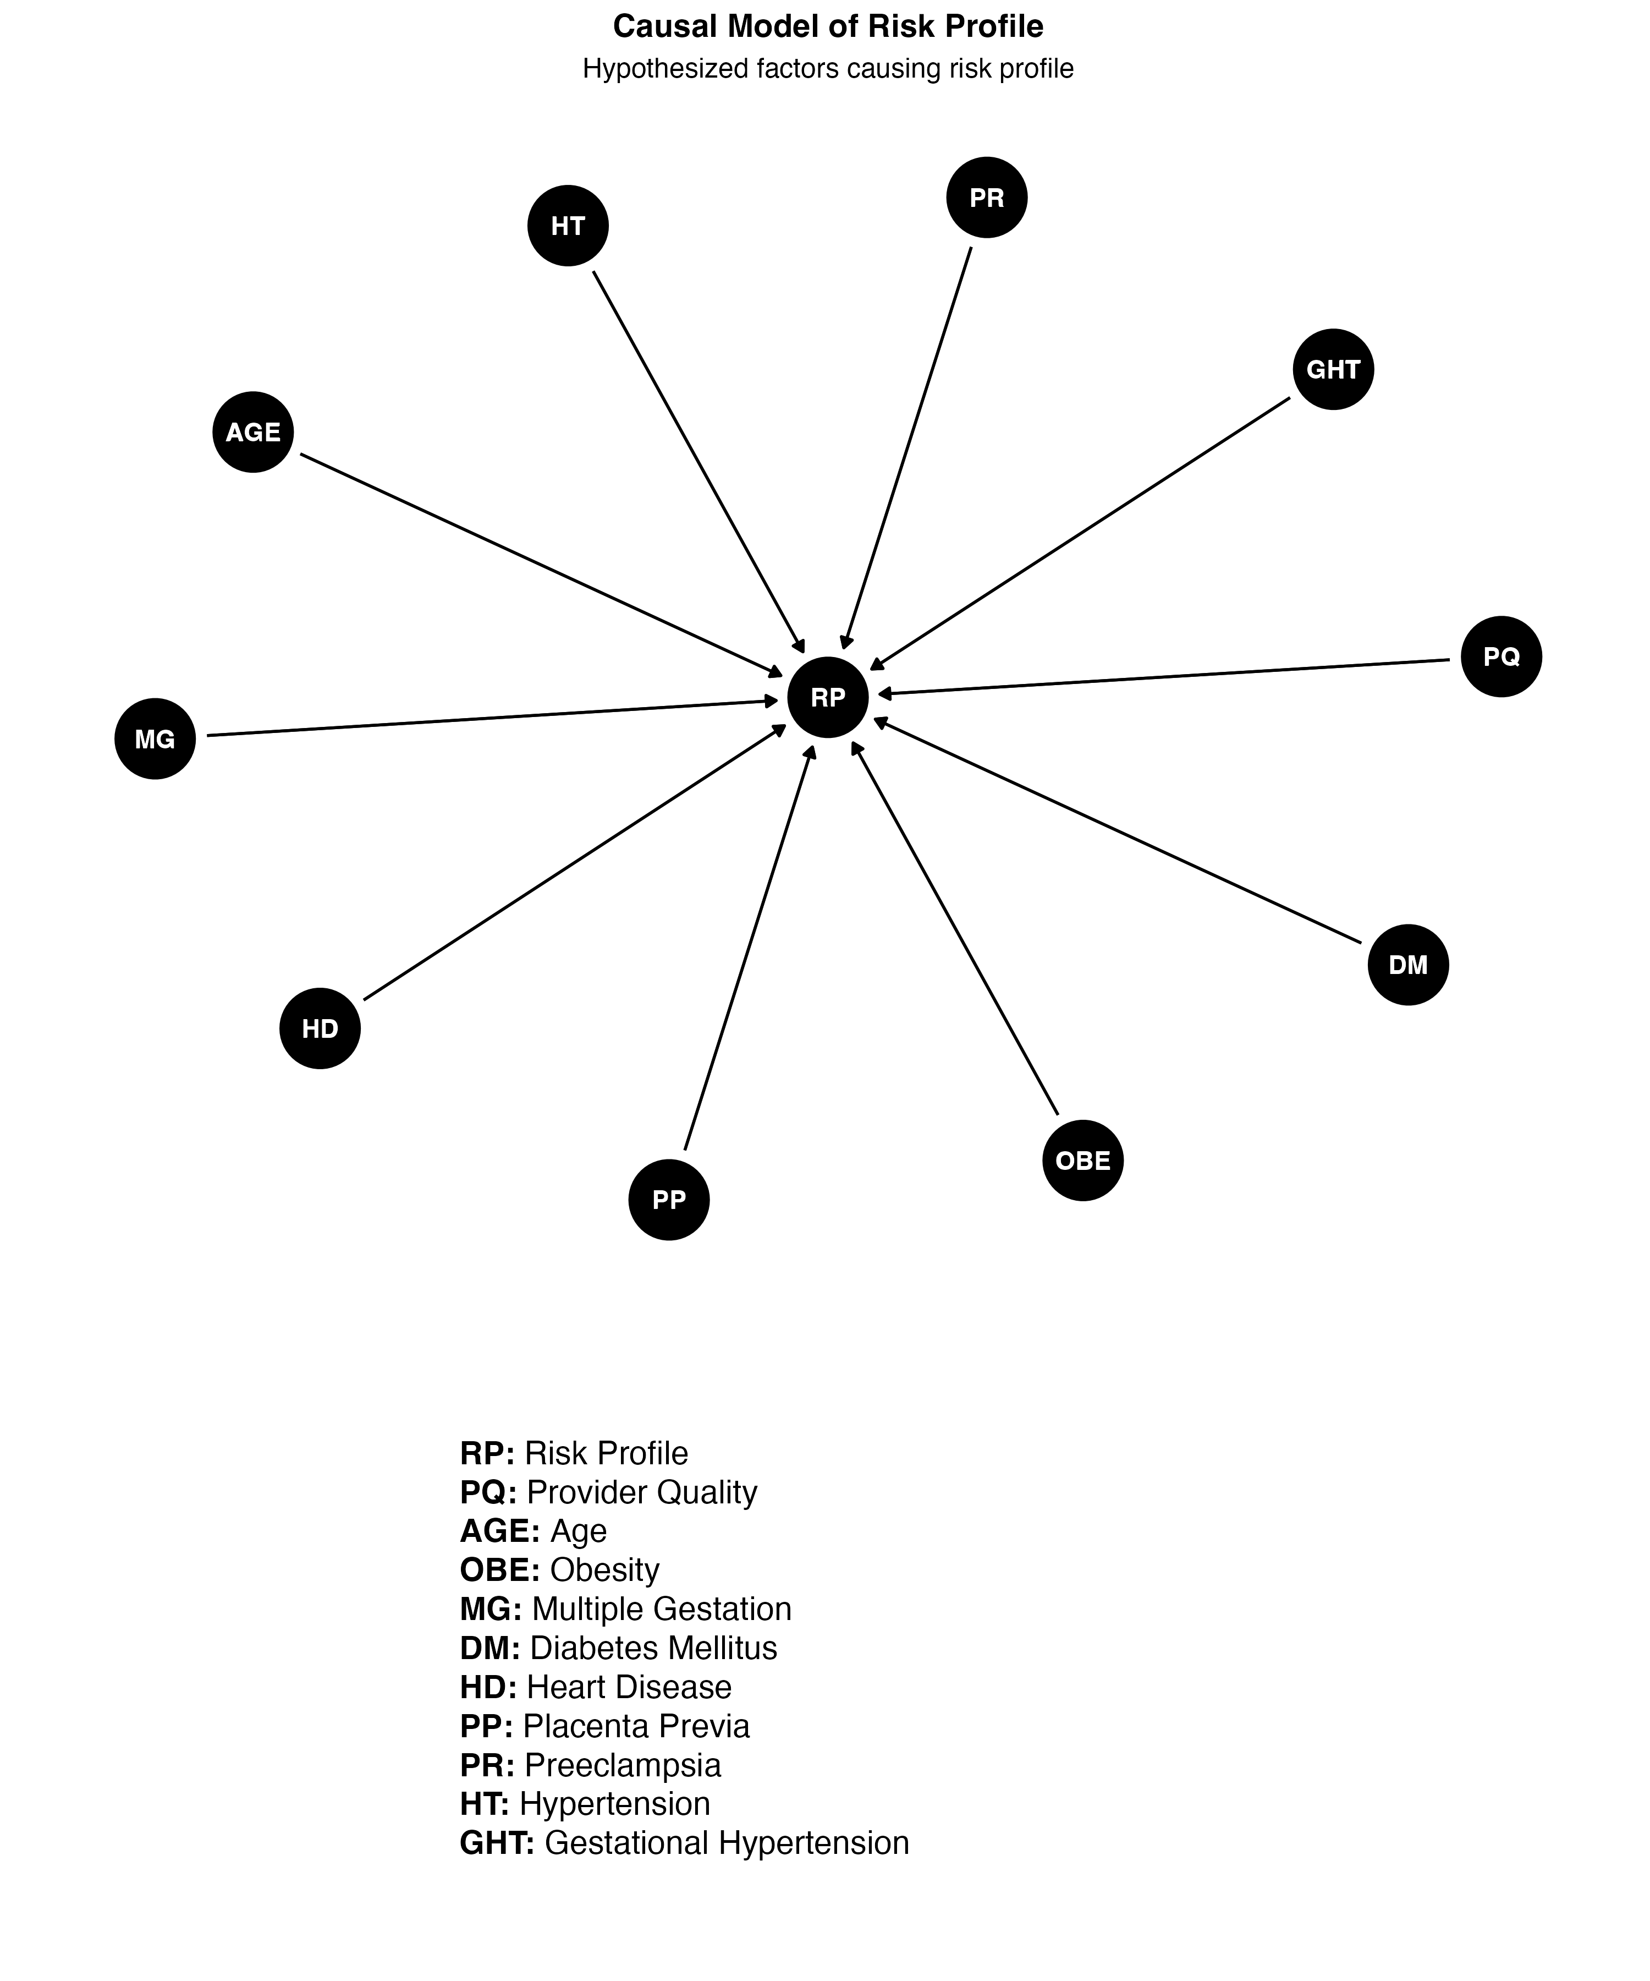
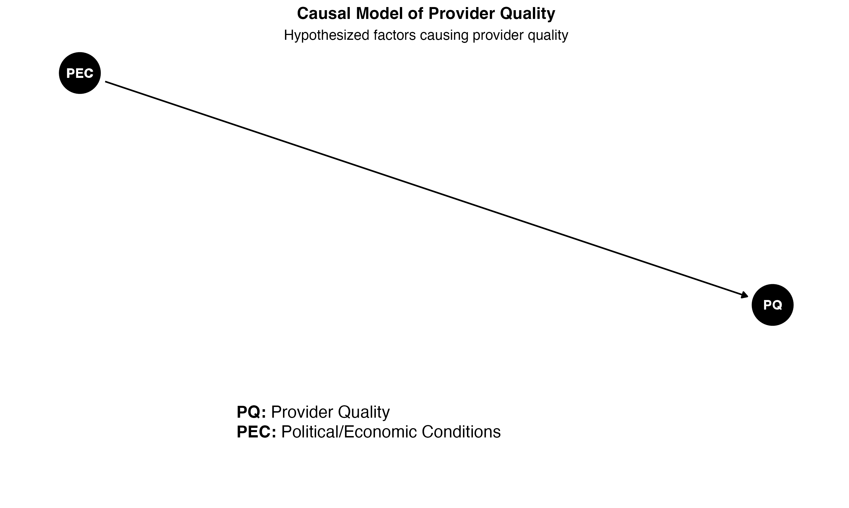

Slide 59
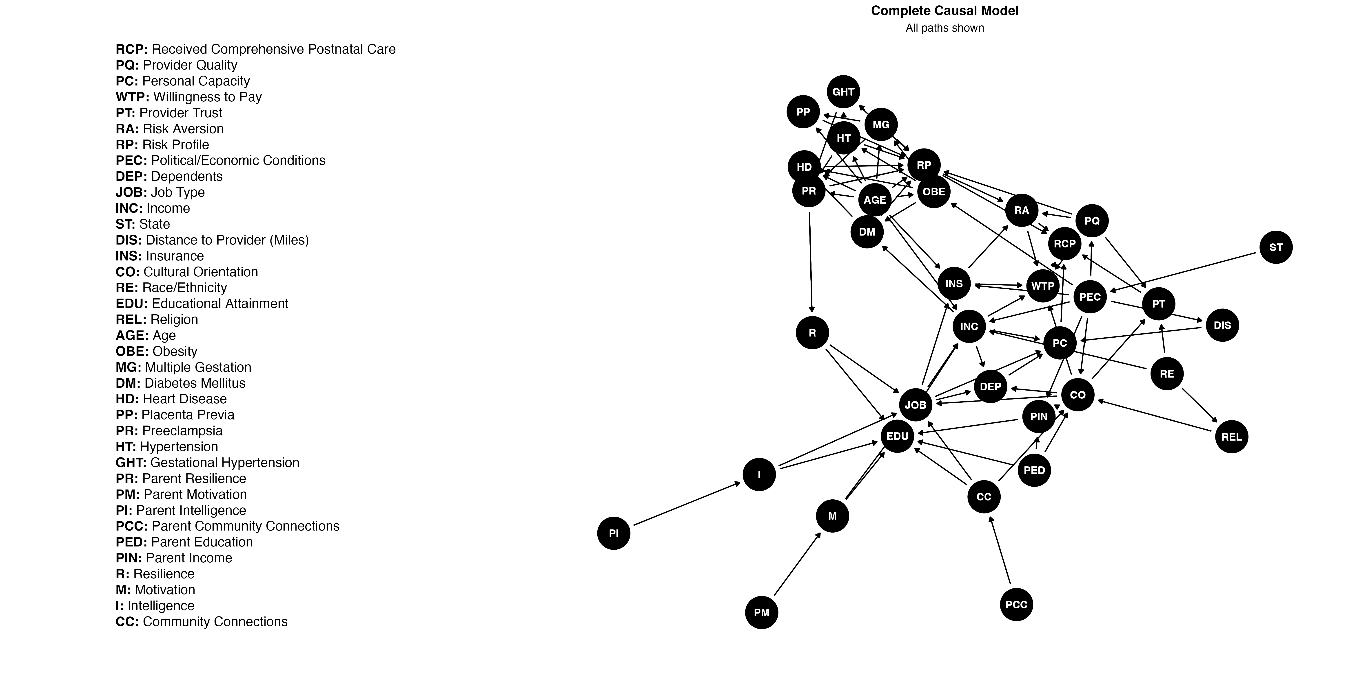
Full Monty

Slide 60
Simulated data
I encoded this causal model into a simulated data of 50,000 patients at 500 hospitals
A useful reminder: reality is complex.
To mimic reality, we’ll analyze the data set that includes things we may actually observe:
their provider
an outcome derived from EHR: did patient have visits resembling guidelines for comprehensive postnatal care?
race/ethnicity from EHR
covariates from EHR
the state someone resides in

Slide 61
Example: Provider Trust
Causal model:
[Provider Quality, Race/Ethnicity, Cultural Orientation] -> Provider Trust
Health-related Political/Economic Conditions -> Provider Quality
Of the above, we only observe race/ethnicity
We do not observe political/economic conditions, but do observe state
Given all this, it may help us to see:
A breakdown of race/ethnicity
A breakdown of receipt of comprehensive care by race/ethnicity
A breakdown of receipt of comprehensive care by state
A breakdown of RCP by race/ethnicity and by state

Slide 62
Race/Ethnicity
Categorical => Bar chart
Geom | R function | Stat/Transformation | Use for
Point | geom_point | Identity | Scatter plots
Bar | geom_bar | Count, Proportion | Bar plots
AB Line | geom_abline | Slope | Line plots
Horizontal line | geom_hline | Y intercept
Vertical line | geom_vline | X intercept
Smoother | geom_smooth | Smoothing f unction (GAM, Loess, etc.) | Showing patterns/trends

Slide 63
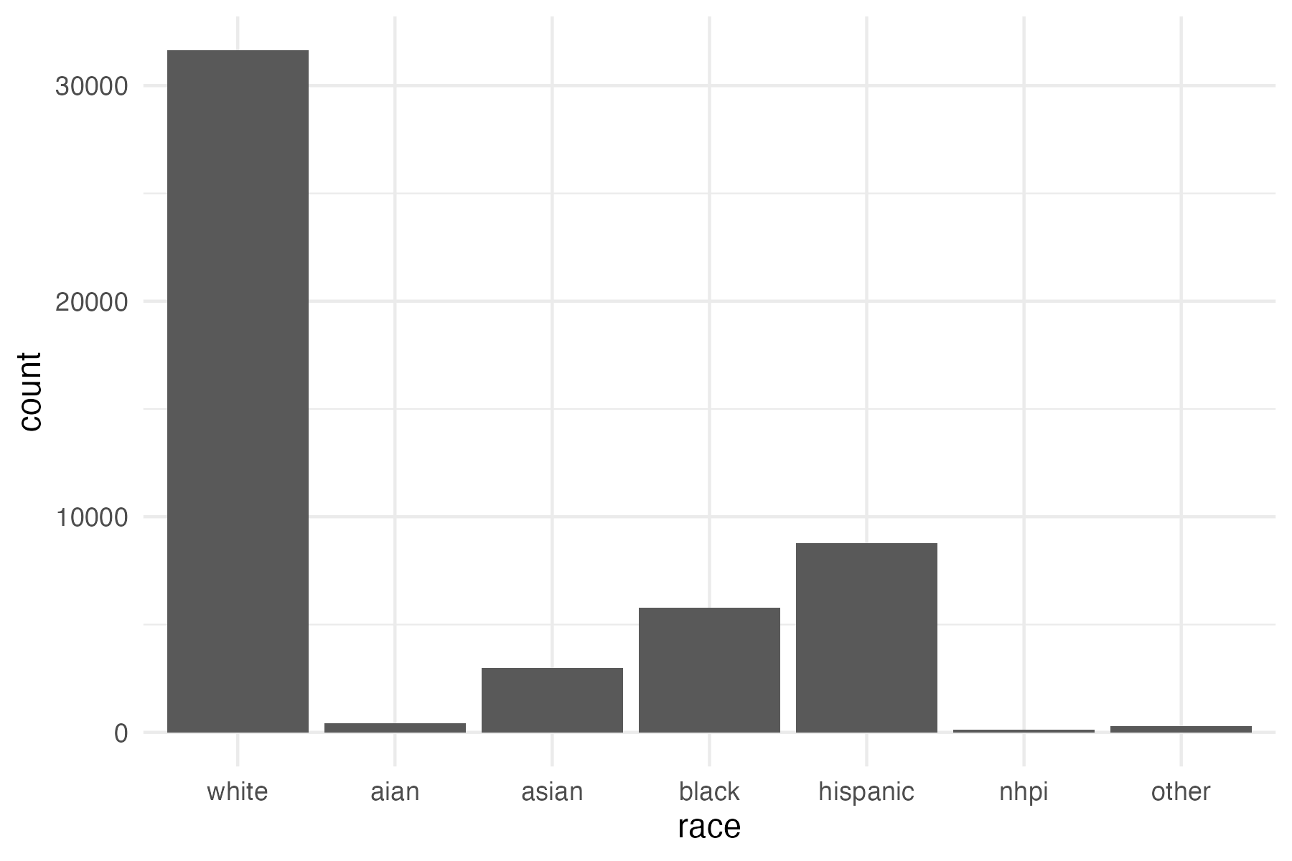
ggplot(data, aes(race)) +
geom_bar() +
theme_minimal()

Slide 64
Race/Ethnicity
The figure needs work:
Flip X/Y in this case will likely help readability
The gray is soul-deadening
We want proportions (this is the stat)
It would be helpful to re-order by proportion
Note: In the code I use the earlier mentioned aggregation technique to make this easier.

Slide 65
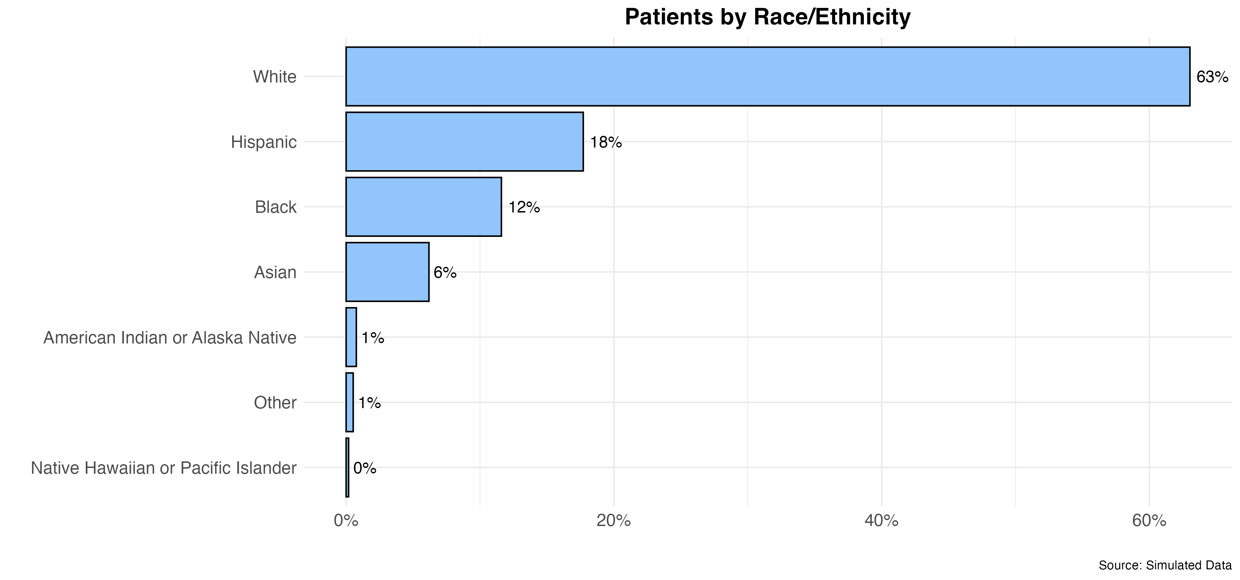
Code on GitHub

Slide 66
RPC v. Race/Ethnicity
We now want to do two variables
With a factor variable, this will look almost identical to the prior plot; be careful to label.

Slide 67
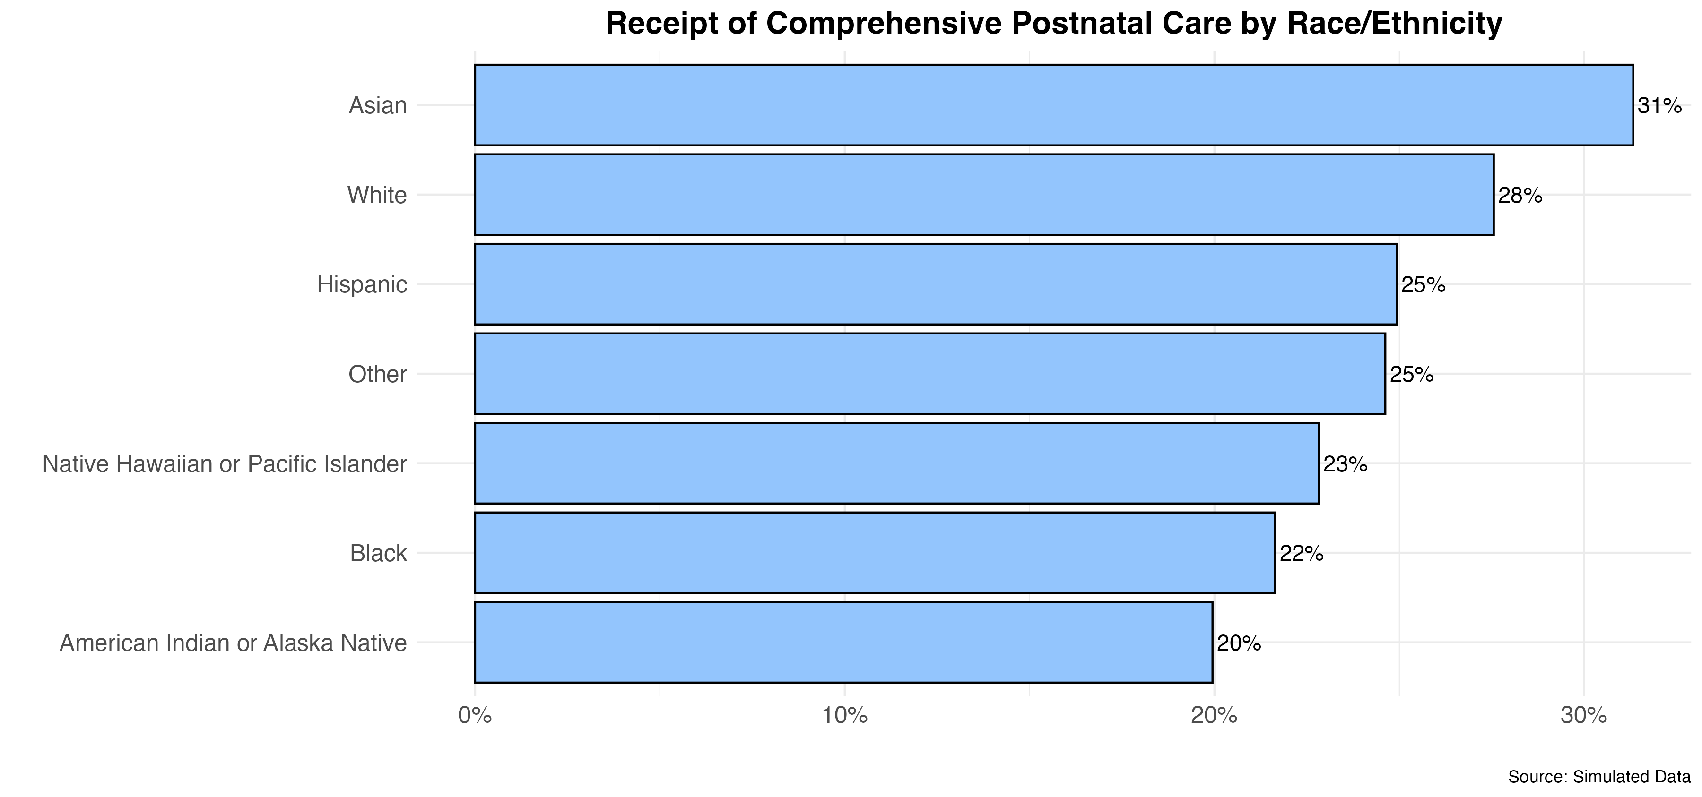
Code on GitHub

Slide 68
RCP v. State
We theorized a path to RCP through provider quality, but we do not have a direct measure of provider quality. However, we hypothesized it may vary by state due to political/economic conditions.
Here we can reach for maps
Maps are complex and can mislead, as can making inferences about larger units (states) from smaller units (patients)
Fallacy of composition
In our simulated data, however, we have a large N and we know individuals represent states comprehensively.
Again, your science must be right for your visuals to make sense.

Slide 69
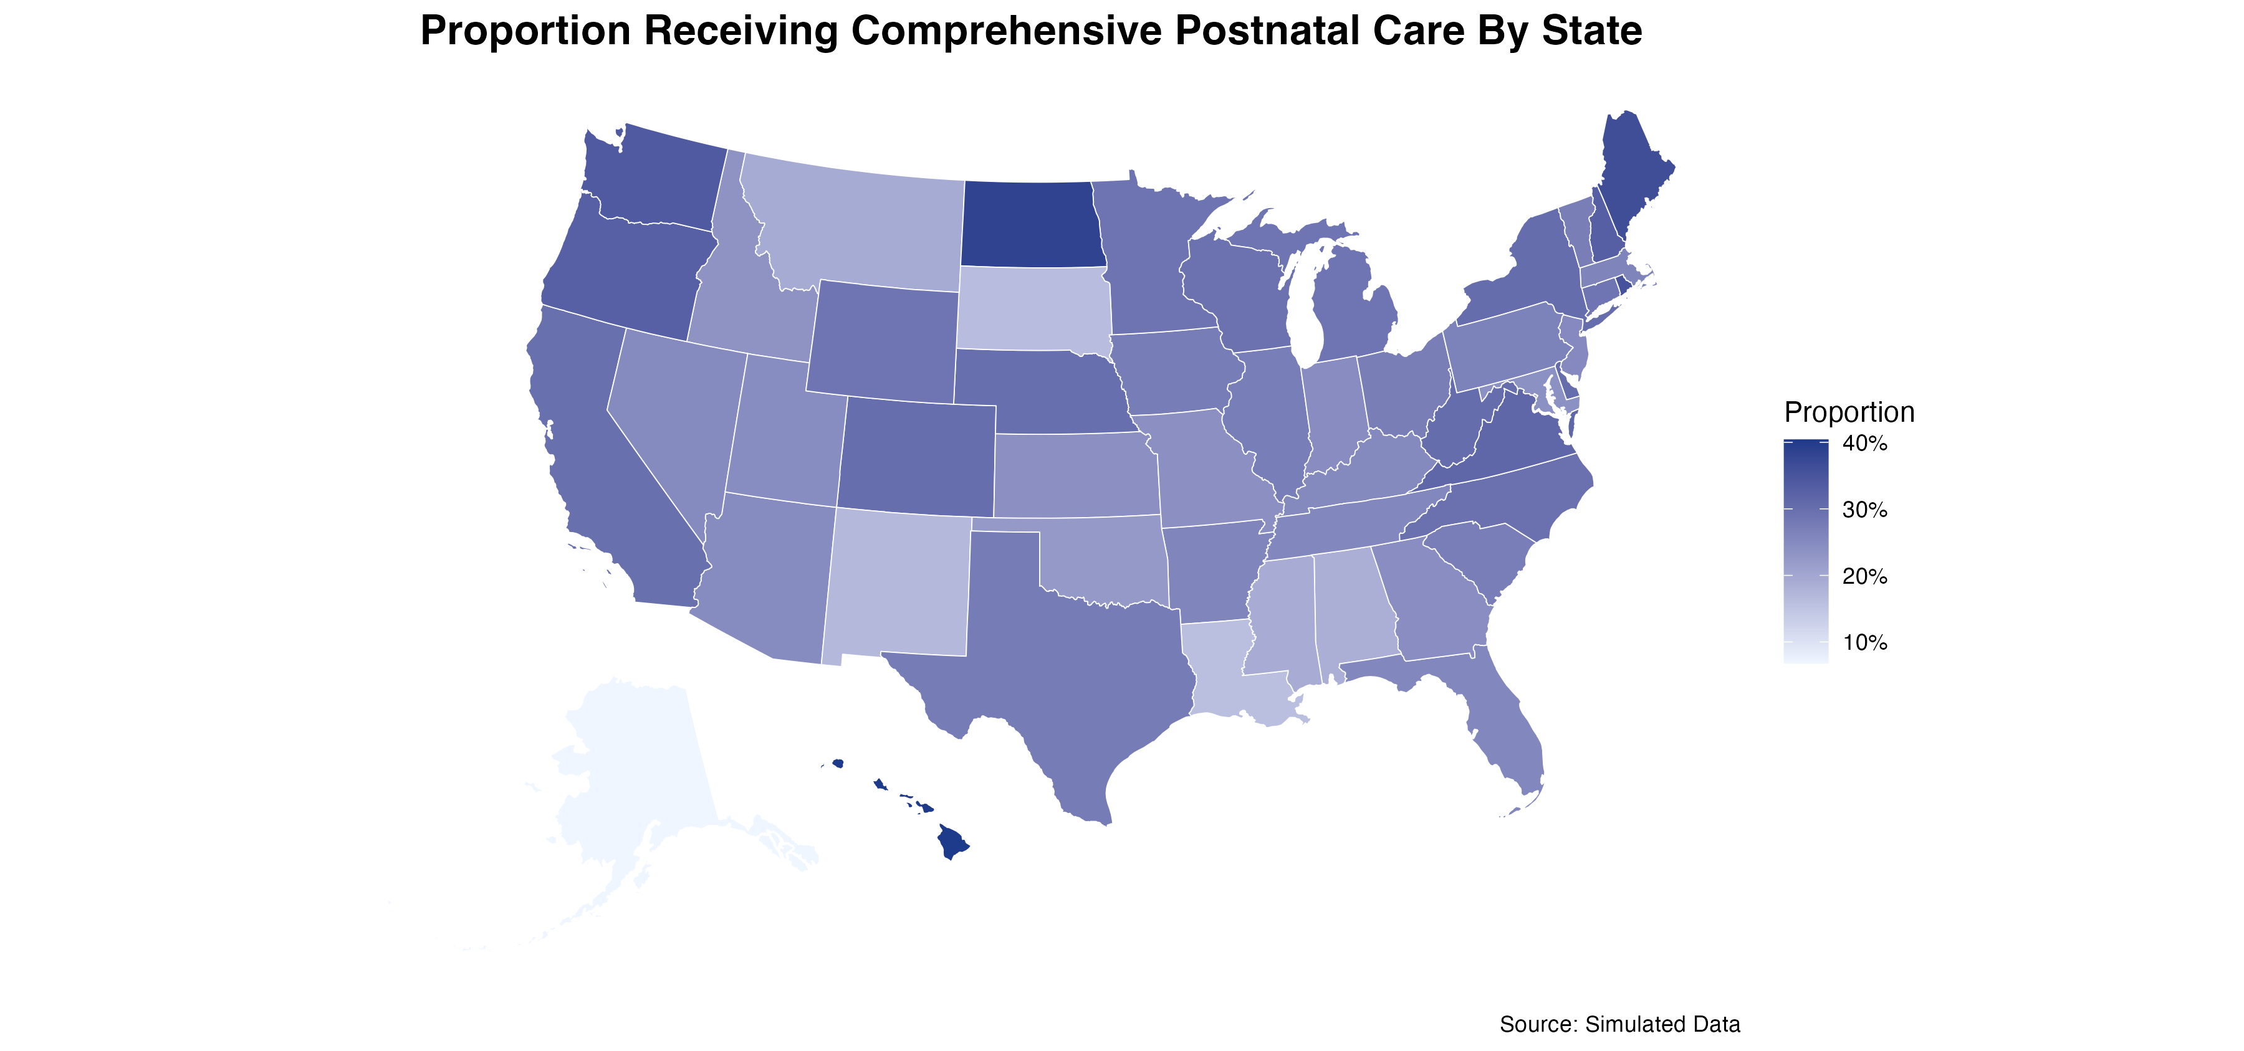
Code on GitHub

Slide 70
Facet by small multiples
It is often useful to facet a map by small multiples. Here we can attempt to facet out this map by race/ethnicity.

Slide 71
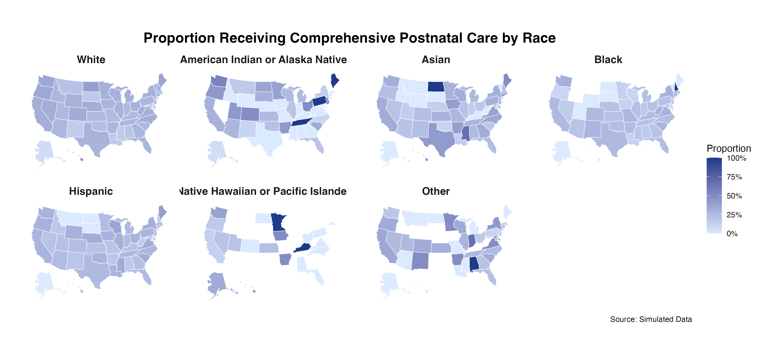
Code on GitHub

Slide 72
Facet by small multiples
I think the result is not so useful. It more just alerts us to our small Ns of certain racial/ethnic groups by state.

Slide 73
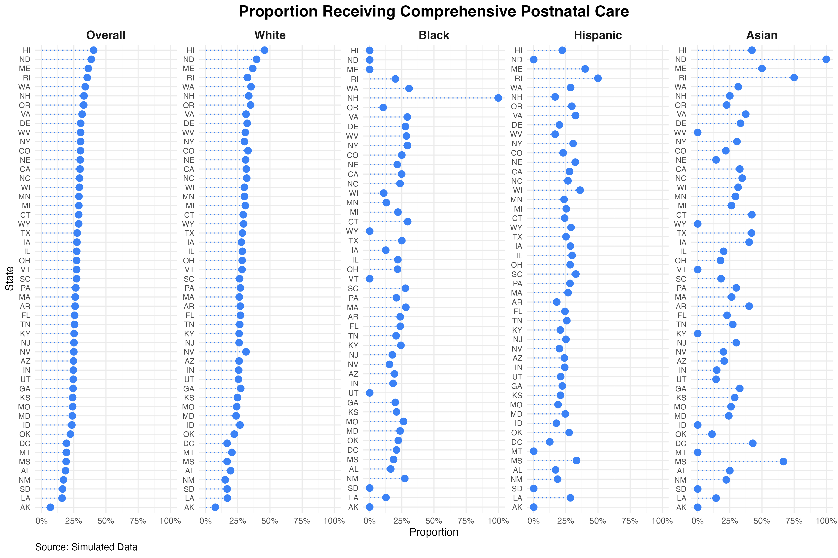
Code on GitHub

Slide 74
Facet by small multiples
Often maps are not what we really want. Here, we will see that a forest plot actually contains way more information; the map was a bad idea!
It is important to experiment.

Slide 75
Visualize Models
Data visualization is not only useful for “seeing your data,” but for understanding and interpreting your models
This is especially true when dealing with interaction effects or polynomial terms
Forest plots are a particularly useful visualization approach to model results.

Slide 76
model <- glmer(
received_comprehensive_postnatal_care ~
race_ethnicity +
log(distance_to_provider) +
insurance +
multiple_gestation +
placenta_previa +
gest_hypertension +
preeclampsia +
(1 | provider_id),
data = data,
family = binomial(link = "logit"))
Random effects:
Groups Name Variance Std.Dev.
provider_id (Intercept) 0.1677 0.4095
Number of obs: 50000, groups: provider_id, 499
Fixed effects:
Estimate Std. Error z value Pr(>|z|)
(Intercept) -1.016372 0.030890 -32.903 < 2e-16 ***
race_ethnicityaian -0.009148 0.125422 -0.073 0.94185
race_ethnicityasian 0.026430 0.044136 0.599 0.54928
race_ethnicityblack -0.285240 0.034707 -8.219 < 2e-16 ***
race_ethnicityhispanic -0.124486 0.029235 -4.258 2.06e-05 ***
race_ethnicitynhpi -0.300750 0.221161 -1.360 0.17387
race_ethnicityother -0.032056 0.140822 -0.228 0.81993
log(distance_to_provider) -0.016890 0.007937 -2.128 0.03333 *
insuranceprivate 0.172615 0.024089 7.166 7.73e-13 ***
insurancestate_provided 0.028901 0.027650 1.045 0.29590
multiple_gestation 0.028812 0.061341 0.470 0.63856
placenta_previa 0.071626 0.103982 0.689 0.49093
gest_hypertension 0.087957 0.046550 1.890 0.05882 .
preeclampsia 0.221400 0.070846 3.125 0.00178 **
---
Signif. codes: 0 ‘***’ 0.001 ‘**’ 0.01 ‘*’ 0.05 ‘.’ 0.1 ‘ ’ 1

Slide 77
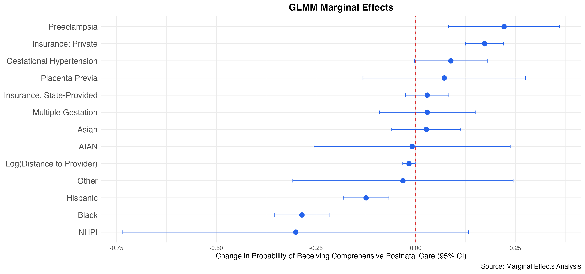
Forest Plot of Avg. Marginal Effects
Code on GitHub
Background on marginal effects: https://thomasleeper.com/margins/

Slide 78
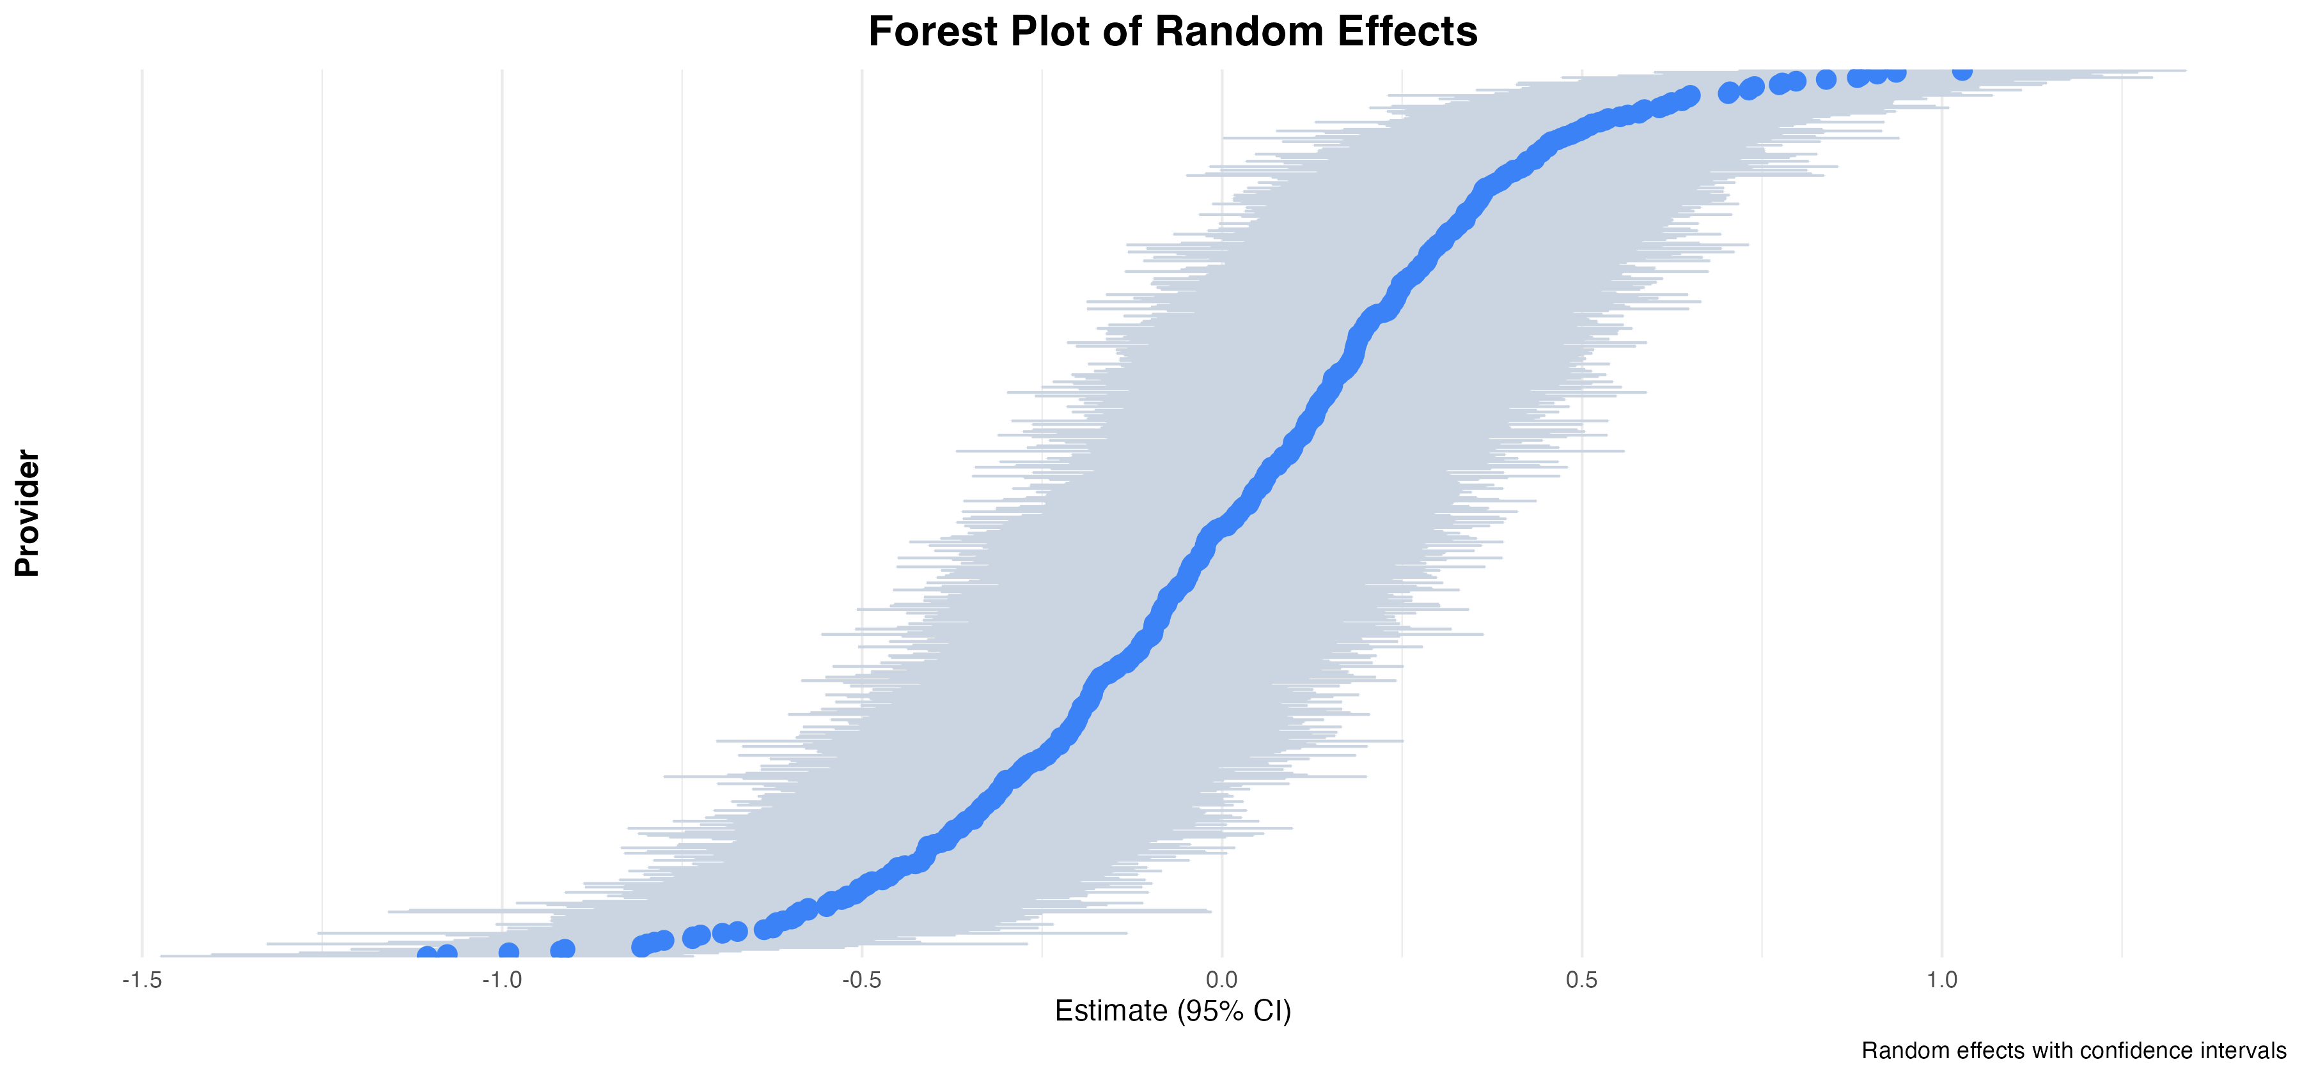
Forest Plot of Random Effects
The pattern here reflects a normal distribution, but these plots often point to outliers.
Code on GitHub

Slide 79
Conclusions
Design is hard; use good defaults.
Creating your desired graphics is now easy with the help of coding assistants; make sure science and good judgment drives your graphics.
Pay attention to your scales.
Looking at data is a crucial step in the scientific process.
When deciding what to visualize, let the science help you navigate. Causal models are a great tool for this.
Visualization isn’t just for descriptive statistics; visualize your models.
Facet by small multiples; don’t overload figures with colors and shapes.
Experiment; your first ideas are not always the right ones.

Slide 80
Resources
🌟 🌟 Data Visualization: A Practical Introduction by Kieran Healy 🌟 🌟
🌟 🌟 Statistical Rethinking: A Bayesian Course with Examples in R and STAN by Richard McElreath 🌟 🌟
Video lectures: https://www.youtube.com/watch?v=FdnMWdICdRs&list=PLDcUM9US4XdPz-KxHM4XHt7uUVGWWVSus
Refactoring UI. https://www.refactoringui.com/
This will help train your design instincts.
Nice colors: https://tailwindcss.com/docs/customizing-colors
R for Data Science: https://r4ds.had.co.nz/

Slide 81
Contact Me
Erik Westlund
ewestlund@jhu.edu
JHBC: https://publichealth.jhu.edu/johns-hopkins-biostatistics-center

Slide 82
Thank you!!

